Slide 1
ATMS 8450 Tropical Meteorology
Anthony R. Lupo
Department of Soil, Environmental, and Atmospheric Science
302 E ABNR Building
University of Missouri – Columbia
Columbia, MO 65211

Slide 2

ATMS 8450 Tropical Met.
Why study tropical meteorology?
1. Most exposure is through media and day-to-day: e.g., current controversy about hurricane numbers and global warming. But you also get exposure from other courses, though not complete (broaden experience)
2. Many interesting phenomena have a tropical met base. (Interesting to discuss)

Slide 3
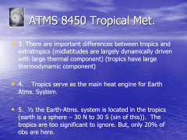
ATMS 8450 Tropical Met.
3. There are important differences between tropics and extratropics (midlatitudes are largely dynamically driven with large thermal component) (tropics have large thermodynamic component)
4. Tropics serve as the main heat engine for Earth Atms. System.
5. ½ the Earth-Atms. system is located in the tropics (earth is a sphere – 30 N to 30 S (sin of this)). The tropics are too significant to ignore. But, only 20% of obs are here.

Slide 4
ATMS 8450 Tropical Met.
How do we define the tropics? Is there a set definition?
One could separate by tropospheric winds (easterlies mainly in the tropics – westerlies elsewhere)
One could define geographically Tropic of Cancer → Tropic of Capricorn.
One could include areas encompassed by the Hadley circulation and encompass the subtropical highs.

Slide 5
ATMS 8450 Tropical Met.
Let’s define as 30º N and 30º S as so to have a very loose definition of the tropics, one that includes all these points.
Important Differences Between Tropics and Extratropics
1. Stability → air is warmer and moister, also upper troposphere higher and cooler, thus, less stable.

Slide 6
ATMS 8450 Tropical Met.
Small pressure and temperature gradients → thus the baroclinic vector is small. Little air mass contrast and almost no fronts. (Fronts do make it down here from the mid-latitudes). Little seasonality.
3. Wind analyses are most common (kinematic) because of the lack of features in the pressure and height fields.
4. Role of the Coriolis force is small, however, on large-scale Geostrophy still holds because both PGF and CO are small. This is only very small along equator.

Slide 7
ATMS 8450 Tropical Met.
5. Weather systems move the other way.
6 Primary precipitation process in tropics is Collision Coalescence in Tropics, but Bergeron in the Extratropics. Only in tall thunderstorms is Bergeron significant
7. Data is heavily dependent on satellites because of there being little land, and the nations that are there are relatively poor.

Slide 8
ATMS 8450 Tropical Met.
Because of the fact that Geostrophy still holds, Vorticity, Divergence, vertical motions, and wind speeds, or your kinematic variables are still of similar magnitude.
Tropics do interact with the extratropics, can’t avoid this. One can look at the differential heating and heat transport (draw) as being evidence of this.

Slide 9
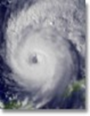
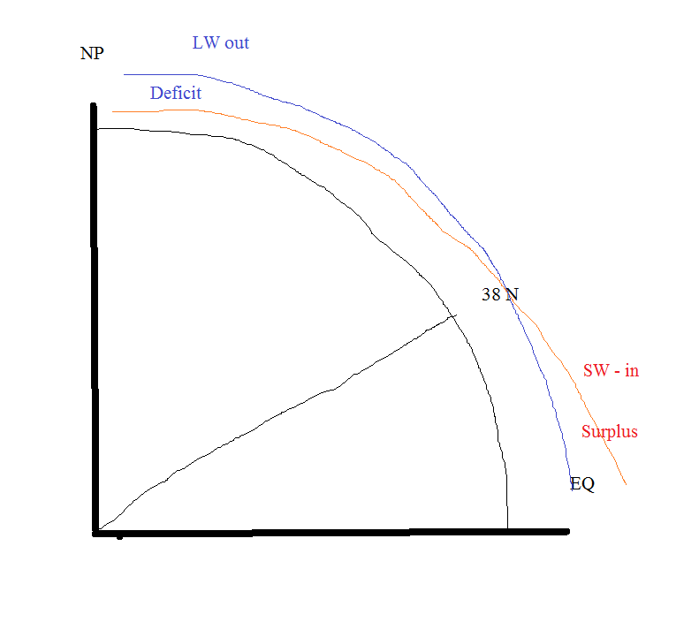
ATMS 8450 Tropical Met.
Energy

Slide 10
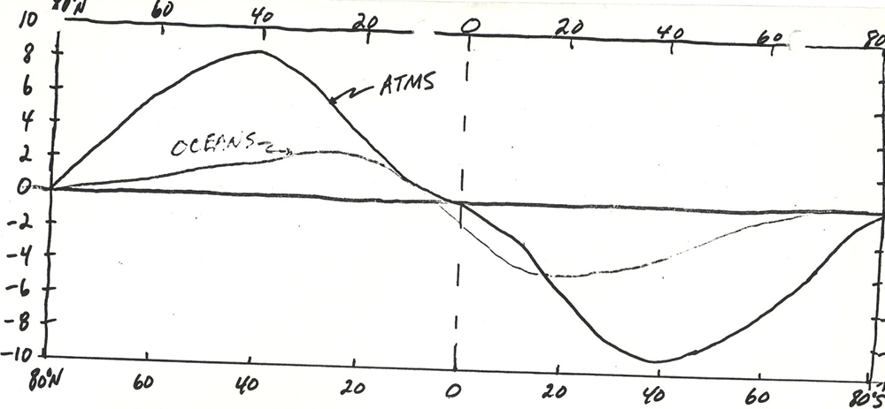
ATMS 8450 Tropical Met.
Energy transport by latitiude:

Slide 11
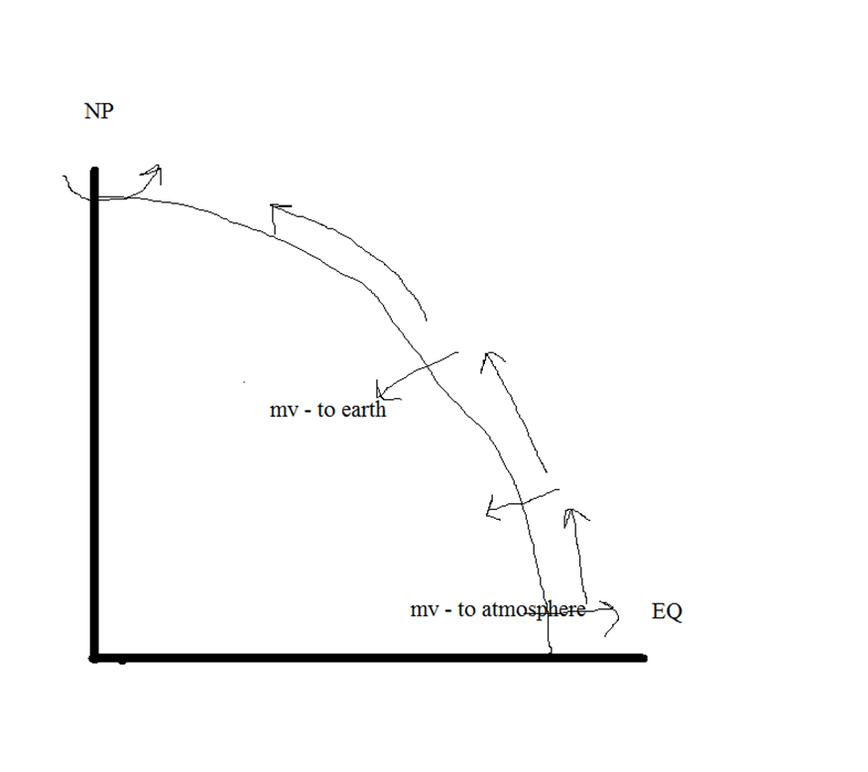
ATMS 8450 Tropical Met.
Momentum balance and transport also suggest this:

Slide 12
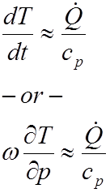
ATMS 8450 Tropical Met.
Extratopics → Largely driven by dynamics:
Equation of motion (Geostrophy, Gradient, and thermal)
Tropics→ From 1st Law of Thermo:

Slide 13
ATMS 8450 Tropical Met.
The adiabatic cooling approximately balances diabatic contributions.
Streamlines and stream functions:
Isogons → Lines of constant wind direction
Isotach → lines of constant wind speed
Streamlines → a vector line that is tangential everywhere to the instantaneous wind vectors. It is a “snapshot” of the flow field at a fixed time.

Slide 14

ATMS 8450 Tropical Met.
Streamlines are trajectories are NOT the same. Trajectories are lines that follow an air parcel. They are only equal if the flow is steady state!
A simple example can show the difference:
Define u, and v.

Slide 15
ATMS 8450 Tropical Met.
We can get trajectories by moving out with time and define where the parcel is. If t = 0, then streamlines and trajectories are the same. (Steady state).
Cool Website:
http://www.atmos.washington.edu/~durrand/animations/vort505/vortanim1.html

Slide 16

ATMS 8450 Tropical Met.
Solve:

Slide 17

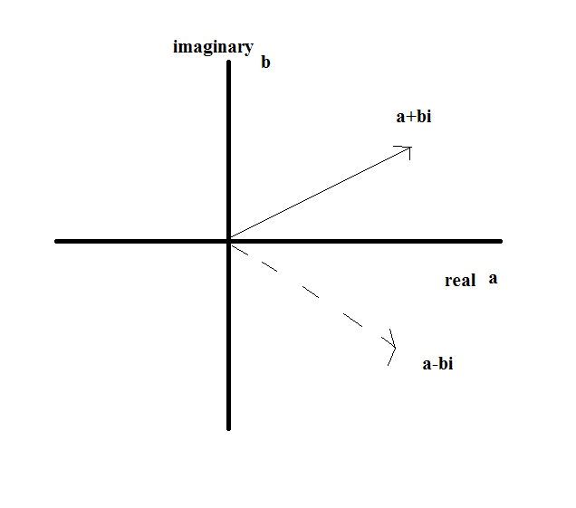
ATMS 8450 Tropical Met.
Complex numbers / conjugates:

Slide 18

ATMS 8450 Tropical Met.
Let’s define:
Then if we take the derivative of the above (first consider)
All the rules are the same! (e.g., prod., power rule, quotient, etc. )
But, if you take the derivative of the conjugate:

Slide 19
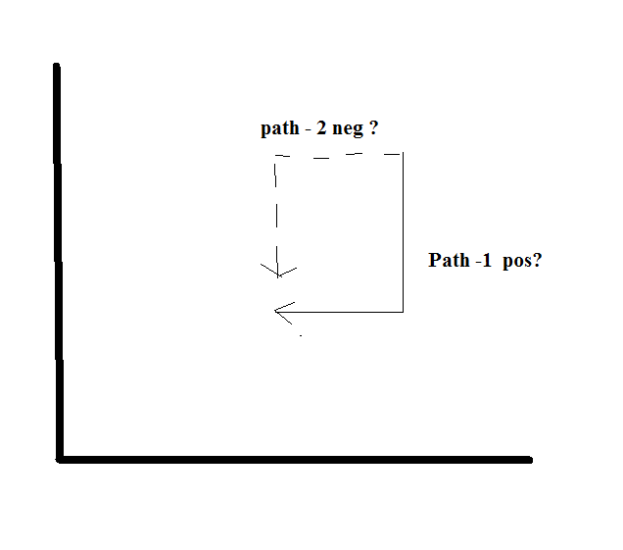
ATMS 8450 Tropical Met.
it does not have a unique solution or path!

Slide 20
ATMS 8450 Tropical Met.
it does not have a unique solution or path!
A function that is analytic is differentiable at all points in a specific domain. Thus, we can test for this using the Cauchy – Reimann equations. This was developed as a test for uniqueness/analyticity.

Slide 21

ATMS 8450 Tropical Met.
These are:
One can easily see that (1) is stretching deformation, while (2) is the shearing deformation from our Atmospheric Science.
OK, let’s take a time-out here and we’ll return to this, let’s test for exactness:

Slide 22


ATMS 8450 Tropical Met.
Equation for streamlines in Cartesian system:
This can only be true if, by above, we can show exactness: (If we can define some streamfunction ψ=ψ(x,y) = constant)
(this exactness test shows the function is integrable)

Slide 23
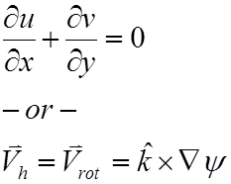
ATMS 8450 Tropical Met.
Then streamlines and stream function are the same, and the flow is non-divergent:
Then if Divergence is not zero, then Stream lines and stream function not the same!

Slide 24

ATMS 8450 Tropical Met.
Now for some levity

Slide 25

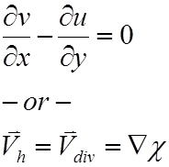
ATMS 8450 Tropical Met.
We can also define the irrotational component (component normal to streamline)
And if irrotational, then:
If Vorticity is not zero, then streamlines and velocity potential (normal component to streamlines) not normal.

Slide 26

ATMS 8450 Tropical Met.
Which gives us Helmholtz’s Theorem:
Now back to Cauchy – Riemann:
If, non-divergent (math) and irrotational (math), then we know that this can only happen if:

Slide 27
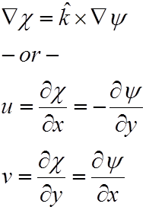
ATMS 8450 Tropical Met.
Here we go!
This is
    pure deformation.
    Geostrophic condition shows up
    See the Cauchy – Riemann conditions to define uniqueness (analyticity)

Slide 28
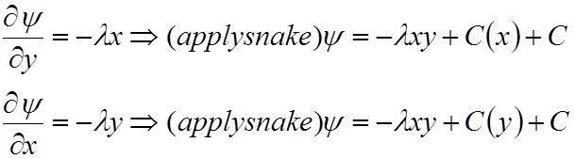
ATMS 8450 Tropical Met.
One can then use one set of conditions or the other and integrate to get hyperbolas:
Where u = λx, and v = -λy.
And y=-λxy+C

Slide 29
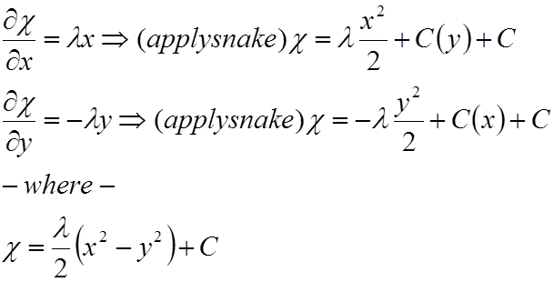
ATMS 8450 Tropical Met.
Or the other!
Deformation!

Slide 30
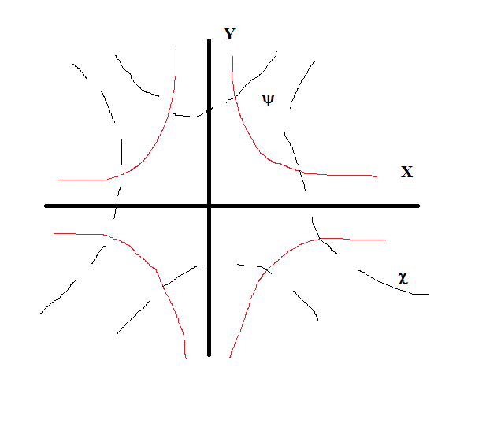
ATMS 8450 Tropical Met.
Deformation!

Slide 31
ATMS 8450 Tropical Met.
Ageostropic motions:
V_{obs} = V_{geo} + V_{ageo}.
This is examined in the context of a component of motion not in geostrophic balance and proportional to the accelerations in the flow:

Slide 32
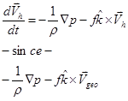
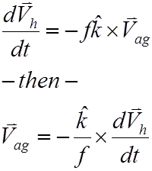
ATMS 8450 Tropical Met.
Here it is
Then:

Slide 33

ATMS 8450 Tropical Met.
In this view, accelerations give rise to ageostropic motions. Is it correct to call these just a "response" to forcing?
Cannot these motions themselves give rise to forcing? Let use Temperature advection as an example?

Slide 34
ATMS 8450 Tropical Met.
It is easy to see the atmosphere as a model that "spins up", but atmosphere is in constant evolution.
OK, we can partition the observed wind into a geostrophic component and an ageostrophic component. We say that the ageostrophic component gives rise to divergence.

Slide 35
ATMS 8450 Tropical Met.
But, does the geostrophic wind contain divergence? This depends on the definition of f! Conversely, is ageostrophic wind purely divergent, or does it contain rotational part?
Let’s look at the geostrophic wind:

Slide 36
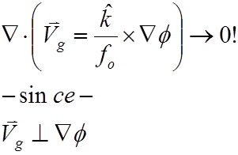

ATMS 8450 Tropical Met.
f_{o} – “theoretician's” geostrophy
Recall your vector calculus identities:

Slide 37

ATMS 8450 Tropical Met.
Now consider; f₁ - synoptician's geostrophy
This wind has divergence!

Slide 38
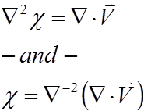

ATMS 8450 Tropical Met.
OK, we can also invoke the Helmholz partition, where:
V_{obs} = V_{r} + V_{d}
Vd ➔ Then:

Slide 39
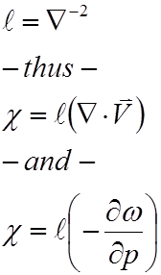
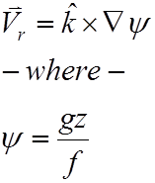
ATMS 8450 Tropical Met.
But I’ll use the notation:
V_{r ➔}

Slide 40
ATMS 8450 Tropical Met.
OK, Trenberth and Chen (1988) state that the geostrophic wind is a diagnostic, thus could be inverted to define geostrophic geopotential field.
➔ We can define this “geostrophic geopotential” as the field, which satisfies geostrophic wind relation. Thus, observed height field must contain an “ageostropic geopotential”.
z_{obs} = z_{geo} + z_{ageo}

Slide 41
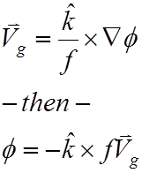
ATMS 8450 Tropical Met.
And:
We can partition geopotential into rotational and divergent portion as well.
Z_{obs} = Z_{r} + Z_{d}

Slide 42
ATMS 8450 Tropical Met.
Trenberth and Chen (1988) get the ball rolling on this concept and later Louge et al (1995) MWR - Dan Keyser's student get fancier with the partition:
Z_{obs} = Z_{r} + Z_{d} + Z_{h} (where h = "harmonic" part of the flow)
Start with appropriate condition:

Slide 43


ATMS 8450 Tropical Met.
Linear (geostrophic) balance - a general and simple balance condition arising from EOM which equates gz stream function with gz/f
This is valid provided that:

Slide 44

ATMS 8450 Tropical Met.
where J is Jacobian and:
Now if:
V_{ag} = V_{obs} - V_{geo}
plug in "synoptician" geostrophy, and Helmholtz Partition to get:

Slide 45


ATMS 8450 Tropical Met.
This stuff:
And this stuff:

Slide 46


ATMS 8450 Tropical Met.
Then:
Now carry out math:

Slide 47

ATMS 8450 Tropical Met.
Get: V_{ag}:
(1) (2) (3)

Slide 48
ATMS 8450 Tropical Met.
OK, Which term disappears if f = fo?
A: term 3 obviously
Why do we do this?
Term 1) is Divergent part of wind.

Slide 49
ATMS 8450 Tropical Met.
Term 2) is Divergent geopotential which initially is in V_{geo} and incorrectly assigned there without Helmholtz partition.
Term 3) is the rotational geopotential that arises from the fact f does not exactly balance due to Earth's sphericity!
➔ The Keyser (Vr + Vd + Vh) partition would be more complex!

Slide 50
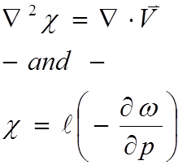
ATMS 8450 Tropical Met.
OK, let's go further and show that various forcing mechanisms contribute to V_{ageo}.
Use relationship for Chi, and continuity.

Slide 51

ATMS 8450 Tropical Met.
Chi is proportional to vertical slope of omega field (variation). In V_{ag}:
Now an omega equation:

Slide 52
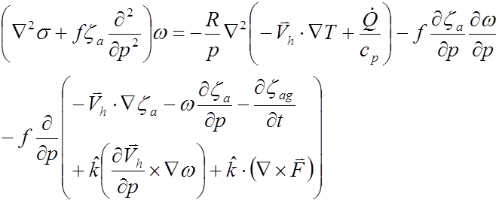

ATMS 8450 Tropical Met.
The equation:
Invert the Laplacian and in symbolic form:

Slide 53
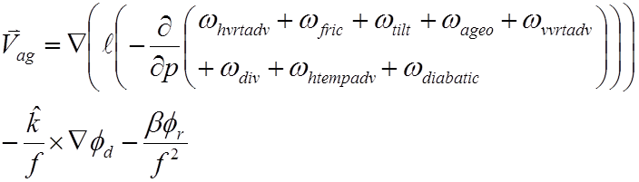
ATMS 8450 Tropical Met.
Put into V_{ag}:
➔ The Celebrated result! This shows that V_{ag} is forced by similar forcings to Omega!

Slide 54
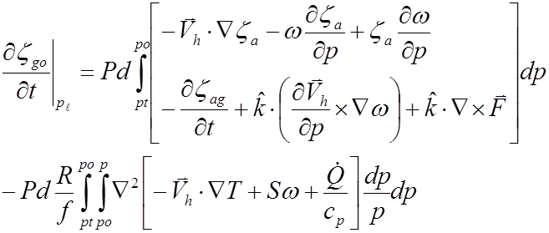
ATMS 8450 Tropical Met.
Next topic: V_{ag} as a forcing?
Start with ZO equation:

Slide 55
ATMS 8450 Tropical Met.
→ Note that there is an ageostrophic term on RHS as a forcing? Is this ageostrophic term a forcing? Lupo et al. (1992) define as a "correction term" to Vorticity tendency.
➔ Use curl of V_{ag} to get Vort (ageo.) (Lupo, 2002), then take time tendency. Now we can see that time tendency of Ageovort is forced by the variation in time of the "vertical slope" of the forcing processes! So now ageostrophic vorticity is a forcing itself and can be partitioned among Z-O forcing processes

Slide 56

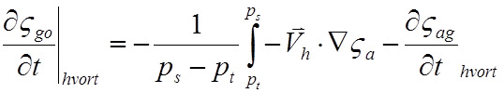
ATMS 8450 Tropical Met.
Here
And

Slide 57
ATMS 8450 Tropical Met.
➔ The larger the Vageo, the larger the forcing, which modulates the forcing process. This iterative process can continue until flow attains new balance or geo balance!
➔ This method produces better results in cyclone and block case studies!

Slide 58
ATMS 8450 Tropical Met.
Tropical Climatology → Climate and Gen Circ.
Climate → defined as a long-term time mean + higher order statistics which describe variability, along with extremes.
There is NO verbage in this definition that addresses the spatial scale! Thus, the definition must be appropriate for the space scale in question.

Slide 59
ATMS 8450 Tropical Met.
Climate change is any change in the long term means or statistics?
How does this differ from the General Circulation?
Gen circ is “planetary” in scale and time scale is two weeks to a few years.

Slide 60
ATMS 8450 Tropical Met.
Gen circ features are not real features that one can observe on a weather map. One can only observe these with time!
The concept of time and space averaging is needed to be learned here:
Hess p. 325 - 335
Piexoto and Oort (various chapters)

Slide 61
ATMS 8400 Tropical Met.
First, let’s look at some basic math:
Reynolds averaging
Instantaneous wind: (u)
u = U + u’ (where prime is a departure from time average, say yearly, seasonally, or any time scale appropriate to the phenomena you’re studying.)
This averaging can be carried out no matter what scales you examine!

Slide 62
ATMS 8400Tropical Met.
u = [U] + u* (where * is a departure from the space average at a given instant, say the average around 40 N.
Then by definition; u’ = 0
[u*] = 0
Also, u = [u] + u* = u + u’

Slide 63
ATMS 8400 Tropical Met.
does [uv] = [uv] ? Mathematically, they are interchangeable, but phyically it makes more sense to time average first and then space average. This is also convention!
u v = (U + u’) (V + v’)
= UV + u’V + Uv’ + u’v’
Then u v = UV + u’V + Uv’ + u’v’
= UV + u’V + Uv’ + u’v’
u v = UV + u’v’

Slide 64
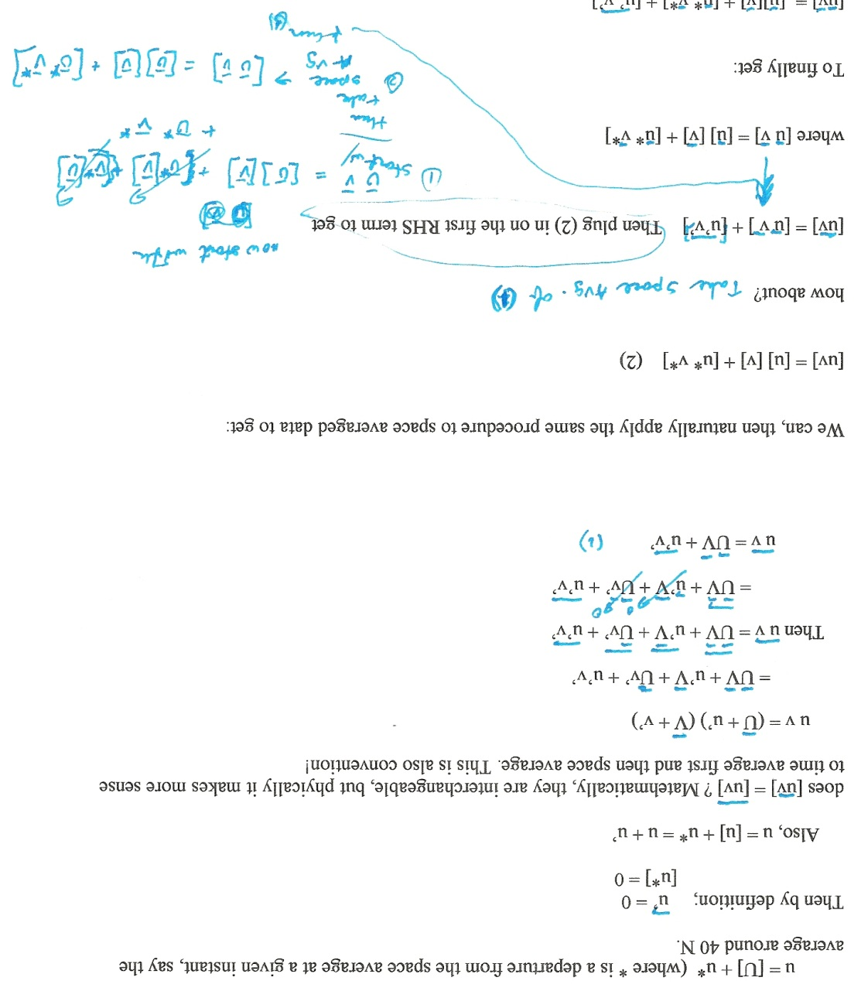
ATMS 8400 Tropical Met.
Scanned in:

Slide 65
ATMS 8400 Tropical Met.
We can, then naturally apply the same procedure to space averaged data to get:
[uv] = [u] [v] + [u* v*] (2)
how about?

Slide 66
ATMS 8400 Tropical Met.
how about?
[uv] = [u v ] + [u’v’] Then plug (2) in on the first RHS term to get
where [u v] = [u] [v] + [u* v*]
To finally get:
[uv] = [u][v] + [u* v*] + [u’ v’]

Slide 67
ATMS 8400 Tropical Met.
LHS = total transport of relative linear ZONAL momentum (v is transport wind)
Term a = transport by mean meridional circulations (Hadley, Ferrel, and Polar direct cells)
Term b = transport by stationary waves or STANDING eddies (Alleutian Low, Bermuda High, monsoon circulations.
Term c = transport by transient eddies (travelling distrubances) (e.g. sit at a point and watch the sign change

Slide 68
ATMS 8450 Tropical Met.
Important Gen circulation features in the Tropical troposphere.
First let’s take a look at the Climate Diagnostics bulletin and see what’s there!
From the Climate Diagnostic Bulletin (http://www.cpc.ncep.noaa.gov/products/CDB)
This publication is devoted largely to the tropics.

Slide 69
ATMS 8450 Tropical Met.
Nino regions, wind anomalies, and OLR diagnostics. Of course with OLR this is good for identifying convection. (T-25)
SST is important (T-18)
Stream function and Isotachs (T-22, T20 – T21)
Div (T-23) Velocity potential (T – 24)

Slide 70
ATMS 8450 Tropical Met.
Ok, first the troposphere, tropical troposphere is deep and unstable, and in the stratosphere, the gradient reverses. See Fig. 1.4
In stratosphere, photochemical processes become very important to describing the general circulation.
Note the location of thermal equator – also stability is less in tropicas, but gradients of T stronger in mid lats. (almost non-existent in tropics).

Slide 71
ATMS 8450 Tropical Met.
Height of Tropical tropo → 15 – 17 km ~80 hPa
ET → 10 – 12 km ~300 – 200 hPa
Polar 8 – 10 km ~ 400 – 300 hPa
Fig. 1.23 see this w/ prifiles and show tropical tropopause is very thin comparatively.

Slide 72
ATMS 8450 Tropical Met.
Fig. 1.7 and 1.8 → Tropics have little season-to-season and year to year temp changes.
But, the ENSO region does show up and is as large as mid-latitudes.
Show Fig. 1.24 and 1.25 show zonal winds as Easterly. Stream functions 1.31 – 1.34

Slide 73

ATMS 8450 Tropical Met.
Show Figs 36 and 37 as velocity potential and the Walker Circulation.
Moisture stuff: Precipitable water PW =
Show moisture and OLR. Hadley circulations.

Slide 74
ATMS 8450 Tropical Met.
Tropical “IRIS” effect → Lindzen et al., 2001.
Very controversial hypothesis, many didn’t accept at first (see Hartman and Michelson (2002) BAMS p 249 – 254). Now there is recognition of such.
Lindzen’s contention → moisture regions and dry regions in the tropical troposphere, very sharp gradients. (See Figs. On moisture in the packet).

Slide 75
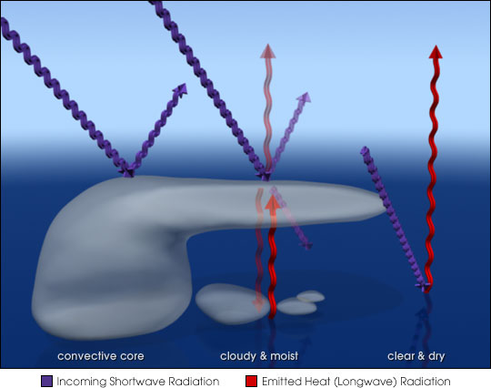

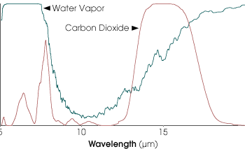
ATMS 8450 Tropical Met.
Climate driven by BC’s. And tropical Cirrus amount (anvil material) inversely proportional to SSTs.
Smaller region with higher SST’s -

Slide 76
ATMS 8450 Tropical Met.
Larger cirrus region would, of course, hold in more heat, covering the dry regions in the Gen Circ.
Smaller Cirrus regions would cover less, letting more infrared out into space.
To me this demonstrates the importance of diabatic processes in Tropics!

Slide 77


ATMS 8450 Tropical Met.
Moisture in tropics typically looked at as being an advective balance process:
Here: moisture flux budget.
OK, Let’s move on to Rossby and Kelvin waves:

Slide 78
ATMS 8450 Tropical Met.
Shallow Water Theory (The Basic Assumptions)
We're going to assume that if the atmosphere can be approximated as a two-dimensional system, since all the conditions and characteristics outlined in "thermal wind" balance can reasonably describe the atmosphere. In addition the vertical scale is much, much, much smaller than the horizontal scale:
H / L <<< O(1)

Slide 79
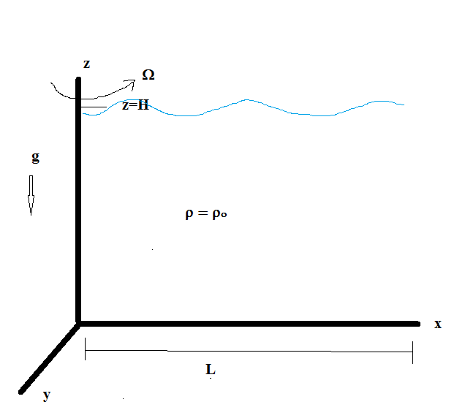
ATMS 8450 Tropical Met.
Also, if all the above approximations hold, then ω <<< u,v. This is our justification for shallow water theory. However, if then shallow water theory is shot!!!
Here is our system:

Slide 80

ATMS 8450 Tropical Met.
Again, one of the fundamental assumptions of shallow water theory is:
Where h(x,y,z,t) = height of the “water” and D is mean depth, where D approximately equals H.
Atmospheric scale height (recall, this is e-folding depth or the atmospheric depth if density were constant) From thermo: H = RT/g

Slide 81
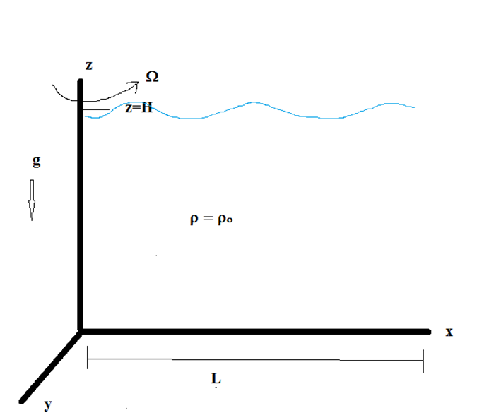
ATMS 8450 Tropical Met.
H ~ O(10 km) and L ~ O(2000 – 10,000 km) Typical Synoptic and Planetary Scale!
OK, let's look back at the "Channel model“. In this system, motions will be “pure” and we can study wave phenomena.

Slide 82
ATMS 8450 Tropical Met.
In the “flat bottom” channel, we can solve the equation of motion and get three solutions (representing Gravity waves or Kelvin type waves, and Poincare waves).
The Rossby Wave:
A slowly evolving inertia wave that owes it’s very existence to bottom “topography”. These waves don’t exist in “pure” form” in the real atmosphere.

Slide 83
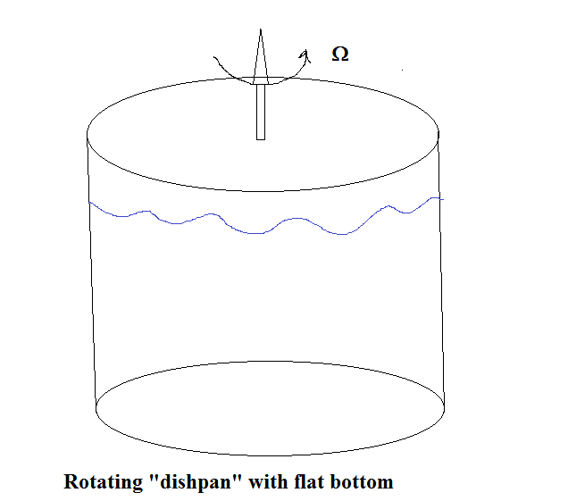
ATMS 8450 Tropical Met.
We must think of topography as not just orography, but the shape and orientation of our “channel”, especially the surface.
Look at the water tank:

Slide 84
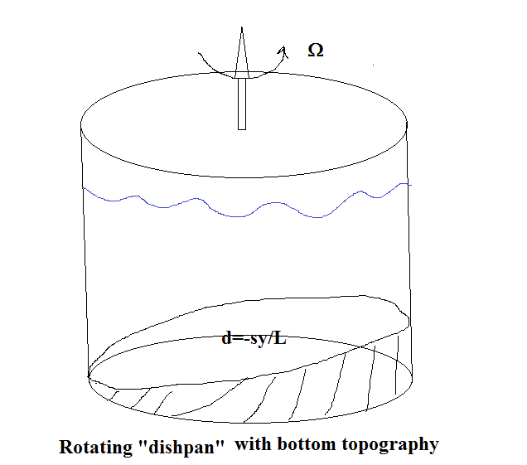
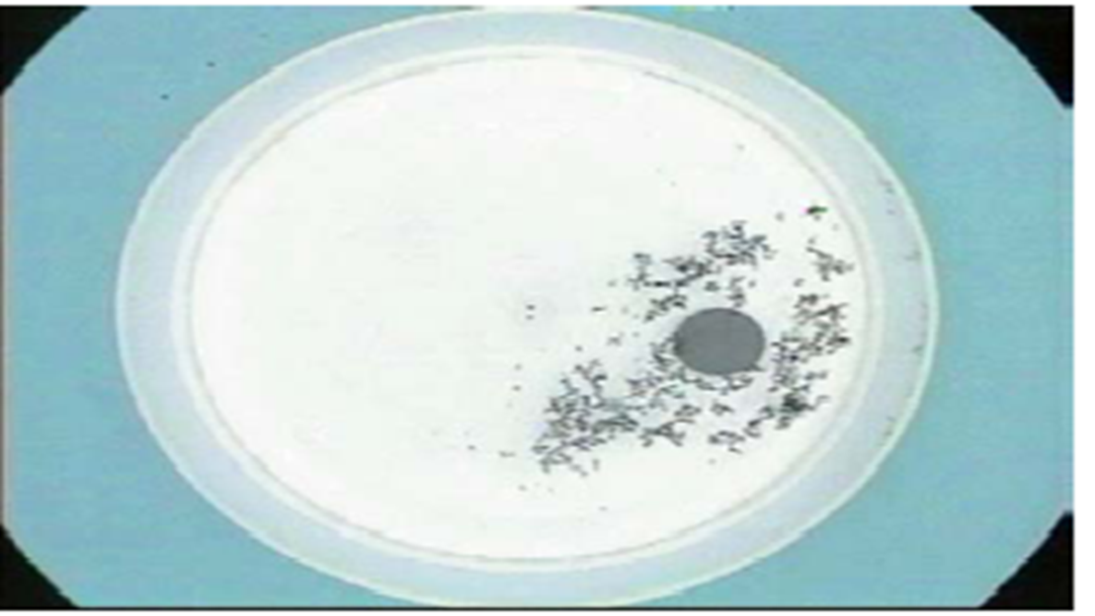
ATMS 8450 Tropical Met.
Dishpan from lab and dishpan with bottom topography:

Slide 85
ATMS 8450 Tropical Met.
Recall continuity in the shallow water body, give us “potential” vorticity (ATMS 9350) : ( ζ + f) / H = Const.
Why is “topography” important?
We’ve made the model more real. So w/different H, or fluid depth, we have different PV in each column! This is how we generate Rossby Waves. PV gradients, in the interior of the fluid are important!

Slide 86
ATMS 8450 Tropical Met.
So lets, specify depth of the fluid as varying in y (kind of like the atms.). Small slope!
Ho = Do(1-(sy/L)) (Each assumption has made the shallow water system a bit more realistic!)
Now... let’s invoke the Gravity Wave Equation from ATMS 9350: (take del dot 2-D N-S and del cross 2-D N-S and combine:

Slide 87

ATMS 8450 Tropical Met.
Here it is, here we let: H be the depth of the fluid: H(x,y,t) is equal to
Ho(x,y) (Time averaged fluid depth) + η(x,y,t) (perturbation depth)
Recall our basic assumptions from shallow water theory:

Slide 88

ATMS 8450 Tropical Met.
Here Ho = Do(1-(sy/L)) (Each assumption has made the shallow water system a bit more realistic!)
Let's go back to our Normal Mode Solution as in "Pedlosky" or:
Plug it in to (1) and do some math and get:

Slide 89
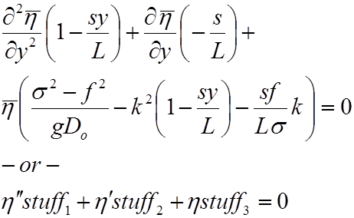
ATMS 8450 Tropical Met.
Here ‘tis (can you do it?):
Omigosh! It's a very highly non-linear Partial Differential Equation!

Slide 90

ATMS 8450 Tropical Met.
Now: The Boundary Conditions (assume v = 0 at y = 0 and y = L) (arise out of vg – we do in more detail in ATMS 9350):
put in normal mode solutions and get (as in ATMS 9350 and for flat bottom):

Slide 91
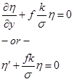
ATMS 8450 Tropical Met.
This mess:
Now since s << 1 so, 1 >>>> (sy/L), so let's reduce the terms to 1, in the GW equation. We’ll “cheat” a bit, but we can't do this everywhere though! This linearizes the equation:

Slide 92
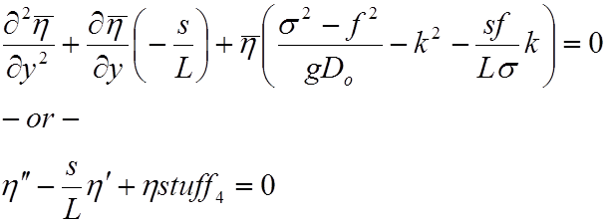
ATMS 8450 Tropical Met.
A little better (from GWE):

Slide 93


ATMS 8450 Tropical Met.
Assume the form:
Now we can solve like any ol' differential equation!!!
Then, you can use the indicial equation:

Slide 94


ATMS 8450 Tropical Met.
Solve this beast (complete square, or use quadratic formula):
Recall (gravity wave phase speed):

Slide 95
ATMS 8450 Tropical Met.
And the solution has the form:
This, like the dispersion relation if we assumed no slope on the bottom and solved the equation using Sturm Liouville technique (Atms 9350), has all three modes (Poincare, Kelvin, and Rossby). There’s more than one way to skin a cat!

Slide 96

ATMS 8450 Tropical Met.
But remember, each addition makes the model more realistic!!! We'll see in a bit the similarity! But, also keep in mind we haven’t included non-linear terms in gravity wave equation yet!
Now let's plug into our general solution:

Slide 97
ATMS 8450 Tropical Met.
Pull out real part:

Slide 98

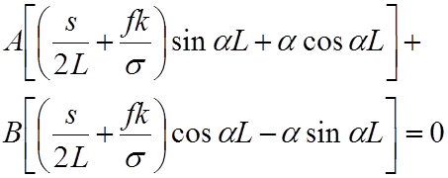
ATMS 8450 Tropical Met.
Ok, recall our B.C. equation and plug in the above for Eta and:
so at y = 0:
and at y = L

Slide 99

ATMS 8450 Tropical Met.
so to solve this for A and B, if we want non-trivial solution then create a 2x2 matrix and calculate the determinant from above!
Then we get:
(A) (B) (C)
So where, then, are the Rossby Modes?

Slide 100
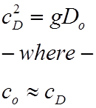
ATMS 8450 Tropical Met.
We’d get an identical looking solution (except c = c_{d} here) to this with a flat bottom channel in which there were no Rossby modes. Where are they?
Term (C) contains Kelvin modes as before, and the bottom topography has precious little impact on the phase speed.

Slide 101
ATMS 8450 Tropical Met.
Term (B) contains inertial oscillation or Kelvin mode (as before)
Thus, by process of elimination; the Rossby Modes are buried in term (A)!
Term (A) Poincare and Rossby Modes.
sin αL = 0

Slide 102


ATMS 8450 Tropical Met.
Let’s look at this harder:
Then:

Slide 103

ATMS 8450 Tropical Met.
Then assuming s << 1 and after a bit’ o’ algebra!
So:
i) If σ > = f (σ/f > = 1) (high frequency waves). We have Poincare (high frequency) waves again!
If this is the case we are assuming (s/L) terms small, or approaching zero! (or equals 0 as in flat bottom)

Slide 104


ATMS 8450 Tropical Met.
Like so….
But, the whole solution (as in the flat bottom case):
We’ve got the Poincare (high frequency) waves again!

Slide 105

ATMS 8450 Tropical Met.
But, if neglected terms are large in my “sigma” relationship two slides back, then you get a relation and three solutions.
) If σ < f (σ/f < = 1) (low frequency waves) We have our Rossby Waves!
If (neglect) and s <<< 1;

Slide 106
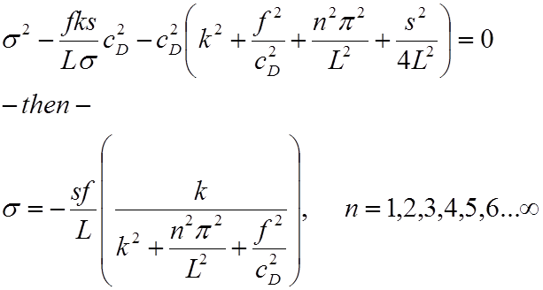
ATMS 8450 Tropical Met.
And:

Slide 107
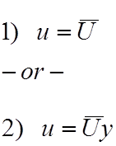


ATMS 8450 Tropical Met.
This looks identical to the Rossby Wave form we learn in Dynamics 4320, except there is no mean flow initially. This is your “beta” term!
We could assume an initial flow in the fluid. See Holton!

Slide 108
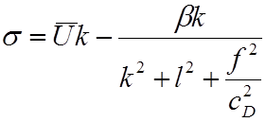
ATMS 8450 Tropical Met.
…..and doing the whole process over again…… to get:
See the resemblance to what you did here and in Atms 4320? Assume “s” here and “Beta – effect” are similar forcing.

Slide 109


ATMS 8450 Tropical Met.
Or we can get this much simpler as we did in Atms 4320:
Became:

Slide 110
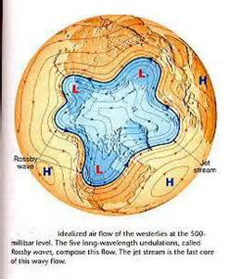
ATMS 8450 Tropical Met.
Rossby waves: A slowly propagating and growing wave that comes from the dispersion relationships found above. These surface waves do not need a vertical boundary and are similar in magnitude throughout the depth of the fluid. (tend to propagate westward in tropics)

Slide 111

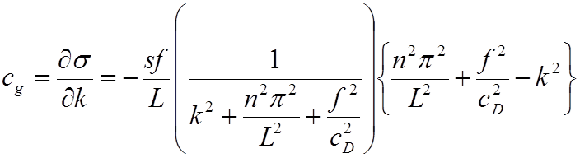









ATMS 8450 Tropical Met.
And after normal mode and solve for c (phase speed).
OK, back to our channel, no initial U. If we take derivative w/respect to k we get:

Slide 112


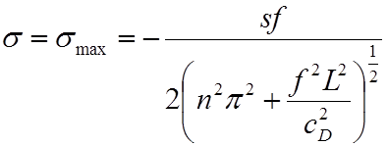
ATMS 8450 Tropical Met.
IF:
Then;
Providing the reference point:

Slide 113

ATMS 8450 Tropical Met.
Might k_{max} and σ_{max}, a stationary solution represent blocking? Such a solution has a wavelength if we calculate it, of roughly 5100 km.
Then if:

Slide 114

ATMS 8450 Tropical Met.
short waves, and these represent Rossby waves propagating eastward. Recall, from Atms 4720, we needed cg to exceed the zonal current for eastward propagation.
And:
long waves, and these represent Rossby waves propagating westward. Recall, from Atms 4720, we needed cg to not to exceed the zonal current for westward propagation.

Slide 115
ATMS 8450 Tropical Met.
Six Oscillations that are germane to the tropics and involve the propagation of Rossby and Kelvin Waves:
1) Semi Annual Oscillation
2) Quasi Biennial Oscillation
3) Madden Julian or Intraseasonal Oscillation
4) ENSO (the 800 pound gorilla!)
5) Indian Ocean Dipole (‘discovered’ in 1999)
6) Atlantic Meridional Mode

Slide 116
ATMS 8450 Tropical Met.
There is one interdecadal oscillation we’ll discuss and that’s the Pacific Decadal Oscillation. This is relatively new as well, but impacts the tropics and mid latitudes alike.
Soooo, let us begin with El Niño……
El Niño:
This was not a household word until the 1980s.

Slide 117
ATMS 8450 Tropical Met.
ENSO had a negative connotation as a ‘destructive’ phenomenon until……
Cost benefit shows it’s a net Positive, so we don’t hear “ENSO bad” anymore.

Slide 118
ATMS 8450 Tropical Met.
History → It goes back to 1600’s….., why named? Walker and Bliss (1932) and the Southern Oscillation and it’s impact on the Indian Monsoon.
Press (Tahiti) – Press (Darwin) = SOI
This is an Atms - Ocean interaction, we’re not sure who starts first. Also, La Nina cond once thought of as “normal”, but this is a “cycle”.

Slide 119
ATMS 8450 Tropical Met.
El Nino and Southern Oscillation / La Nina (www.COAPs.fsu.edu)
El Nino has a periodicity of 3 - 7 years. (Philander, 1989)
Defined by JMA as 5 straight months of the running 6-Month SSTs being < -0.5º C from the climatological mean. (“trenberth” defn < 0.4º C)

Slide 120
ATMS 8450 Tropical Met.
EL Nino history;
Noted in S. America by the indigenous peoples of the region and “coined” El Nino by the Spanish in the 1660’s.
Sir Gilbert Walker and the Southern Oscillation in the 1920s.

Slide 121
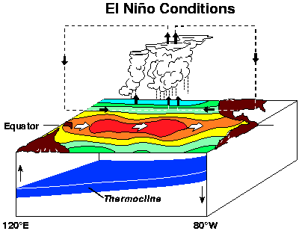
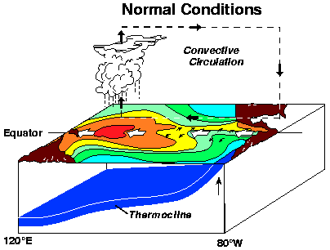
Atms 8450 Tropical Met.
J. Bjernes (1969) links SO to El Nino. El Nino of 1982-1983 makes news! (Images “stolen” from PMEL – NOAA
West Pac (higher press, lower precip, cooler warm pool) East Pac (lower press, higher precip, warmer cold waters)
Weak Walker circ, and convection in the west Pacific. NE and SE trades, are weak. Upwelling suppressed east and show counter currents.

Slide 122
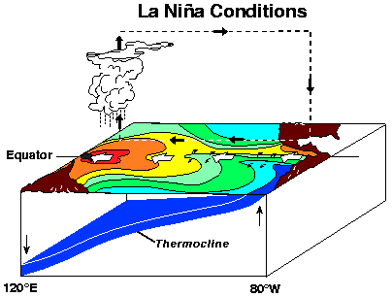
ATMS 8450 Tropical Met.
La Nina
West Pac (Low press, high precip, warm pool) East Pac (high press, low precip, cold waters)
Strong Walker circ, and convection in the west Pacific. NE and SE trades, are strong. Upwelling east and show currents.

Slide 123

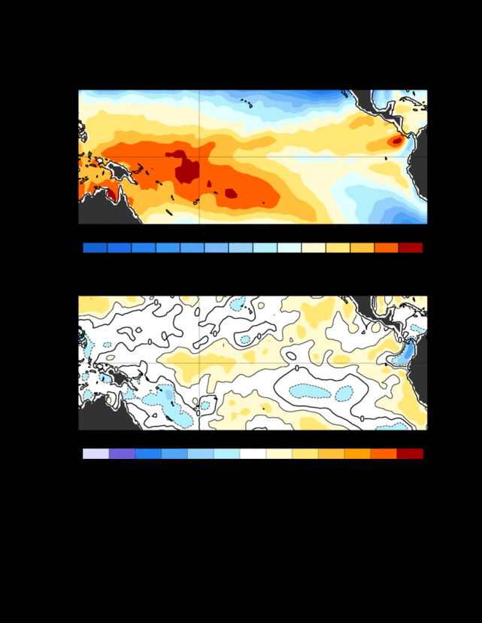
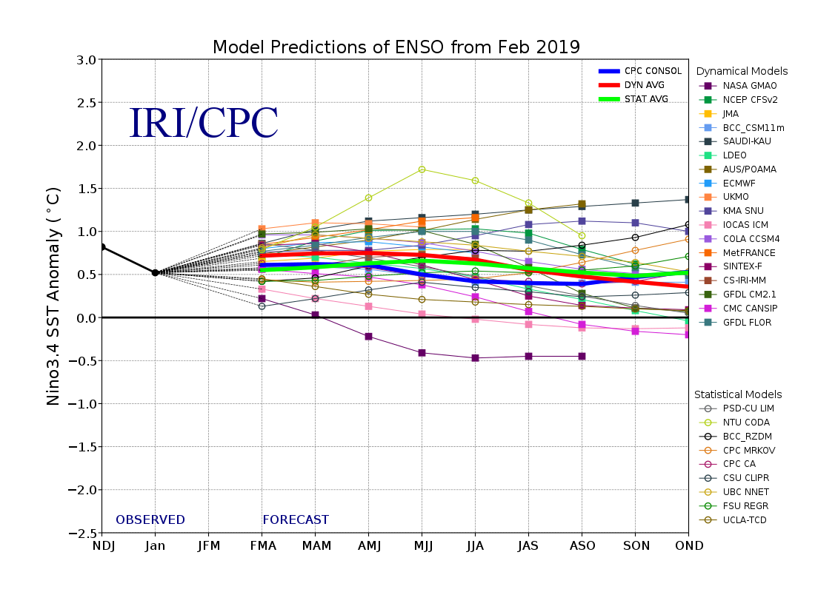
ATMS 8450 Tropical Met.
El Nino 2018 – 2019 Feb 13 2019

Slide 124
ATMS 8450 Tropical Met.
La Nina 2021 – 2022 Feb 2022

Slide 125



ATMS 8450 Tropical Met.
La Nina 2022 – 2023 March 2023

Slide 126
ATMS 8450 Tropical Met.
El Nino Lifecycle: in West Pacific, April – July Thermocline begins to become depressed, winds in the tropics begin to weaken.
El Nino sets in typically in DEC and lasts 1.5 yeas until about July of the next year. It is not known whether the oceans are responsible or the atmosphere is responsible for kickoff. It is thought that oceanic Kelvin waves are responsible for transport of warm waters eastward. The walker criculation is “upset” or “displaced.

Slide 127
ATMS 8450 Tropical Met.
El Nino thought to be connected to Earth’s revolution around the sun.
Not only do warm waters migrate east, but the sun can now warm the waters in the East Pacific since upwelling suppressed.

Slide 128
ATMS 8450 Tropical Met.
Maximum convection pushed from indonesia to central pacific. Low level easterlies weaked or actually become westerlies.
El Nino is tied to Southern Oscillation:
SO Index = Darwin (Aust) - Tahitti
Low press. normal ( + anom.) (High pressure here. (negative anom.)

Slide 129


ATMS 8450 Tropical Met.
FROM CDB:

Slide 130
ATMS 8450 Tropical Met
Although pressure anomalies show up they are not by them selves necessary or sufficient! When SST anomalies occur with pressure anomalies, then the ENSO event is occurring.
Philander (1989) : ENSO (pressure anomalies), inc. precip in central pacific (or OLR anomalies), increased westerly stress, and SST’s shifted eastward.
Upper troposphere: Two anticyclones, one in each hemisphere develop aloft (upper level outflow from convection) in Central Pac.

Slide 131
ATMS 8450 Tropical
The Pacific North America pattern (PNA) : Pacific anticyclone, Alleutian low, Ridge upstream , and Low pressure over SE US. This becomes in opposite phase during El Nino years. Lupo and Bosart (1999) Unusual PNA.
ENSO amplitude and period “modulated” by longer term fluctuations such as the PDO (see Mokhov et al. 2004) Weak ENSOs associated with SSTs in mid-Pacific, Stronger in East Pac (Clarke and Li, JoC, 1997). Kung and Chern (1995), and Kelsey et al (2007) Lupo et al. (2008) Birk et al. (2010) associate ENSO and La Nina SSTs with different clusters.

Slide 132
ATMS 8450 Tropical Met.
Jin (1997a,b) and the “recharge-discharge oscillator” - Fedorov et at 2003 July BAMS - ENSO is linked to seasonal cycle, MJO, etc. Strength of ENSO controlled by, thermocline depth and horizontal SST gradients.

Slide 133
ATMS 8450 Tropical Met.
ENSO timeline → 12 to 18 months
1) March – July, trades relax and thermocline depresses, Walker circulation weakens
2) July – Dec, warm waters to the east, counter current stronger, and convection moves east.
3) Feb – July, ENSO dissipates and La Nina or neutral returns as geostrophic flow becomes reestablished. Stronger trades and Walker circulation. Upwelling returns.

Slide 134
ATMS 8450 Tropical Met.
Definitions:
NOAA SST’s > = 0.5 C El Nino
<= -0.5 C La Nina
Monthly means in the Nino 3 or 4, or 3.4 region.
Trenberth Defn:
SST’s >= 0.4 C El Nino
<= -0.4 C La Nina
JMA / COAPS –Lupo
SST’s >= 0.5 C El Nino
<= -0.5 C La Nina
Both of these use a 6 consecutive months of 5-mon running means.

Slide 135
ATMS 8450 Tropical Met.
ENSO Typing
Again, we've stated that SST forcing induced by SST anomalies are most important in 2 - 7 year range for LRF, thus the trend and persistence of these are of concern to us naturally.
Kung et al.
Objectively applies "clustering methods" (identifying or filtering out "types" or "regimes", which may correspond to "solutions." to our basic equations), and then manually checking each month to classify SST anomalies.

Slide 136
ATMS 8450 Tropical Met.
This work used monthly SST's from 1955 to 1993 and recognised 7 types of SST patterns. NOTE that this is up to 1993, before PDO widely recognised. This work was extended by my group during 2002 – 2003. I’ve already passed out one publication.
Type A, B, C, D, E, F, G.
Kung noted the climatological shift in 1970's, wasn't able to identify the cause (note McPhaden 1999 also says that the PDO is not well known).
Note the preponderance of type A and D in the 1950's and 1960's and Band C in the 1970 - 1976. (This is PDO2 1947 - 1976). Then from 1977 on E and F's are dominant. El Nino occurrence also increased as we know.

Slide 137
ATMS 8450 Tropical Met.
From Lupo et al. (2008)
Table 2. The monthly classification of global SSTs from 1955 – 2016. The classifications from 1955 – 1993 are adapted from Kung and Chern (1995).
Year | Jan | Feb | Mar | Apr | May | June | July | Aug | Sept | Oct | Nov | Dec
1955 | A | A | A | A | A | A | A | A | A | G | G | G
1956 | A | A | A | A | A | A | A | A | A | G | G | G
1957 | G | A | A | A | A | F | F | F | F | F | F | D
1958 | D | D | D | D | D | D | F | F | F | D | D | D
1959 | D | D | D | D | D | D | A | A | A | A | A | A
1960 | A | A | A | A | A | A | D | A | A | A | G | A
1961 | A | A | A | A | A | A | A | A | A | A | G | G
1962 | G | G | G | G | G | G | G | D | G | G | G | G
1963 | A | A | D | D | D | D | D | D | D | D | D | D
1964 | D | D | A | D | A | A | A | G | G | G | A | A
1965 | A | A | A | A | A | A | A | F | F | F | F | F
1966 | D | D | D | D | D | A | A | A | A | D | D | D
1967 | A | A | A | A | A | A | A | A | A | A | A | A
1968 | A | A | A | A | A | A | A | F | F | F | D | D
1969 | D | D | D | D | D | F | D | E | E | E | D | D
1970 | C | C | C | C | C | C | C | B | B | B | B | B
1971 | B | B | B | C | B | B | B | B | B | B | B | B
1972 | B | B | B | C | C | C | C | F | C | C | C | C
1973 | C | C | C | B | B | B | B | B | B | B | B | B
1974 | B | B | B | B | B | B | B | B | B | B | B | B
1975 | B | B | B | B | B | B | B | B | B | B | B | B
1976 | B | B | B | B | B | B | B | C | C | C | F | F
1977 | C | C | C | B | B | E | E | E | E | E | C | F
1978 | F | F | F | E | E | B | C | E | E | C | F | F
1979 | C | C | C | C | C | C | F | F | F | F | F | F
1980 | F | F | F | F | F | E | E | E | E | E | E | E
1981 | F | F | F | C | C | E | E | E | E | E | E | E
1982 | E | E | E | E | C | F | F | C | C | C | C | F
1983 | C | F | F | F | F | F | F | E | E | C | E | E
1984 | E | E | F | B | E | B | E | E | E | E | B | B
1985 | B | B | B | B | B | E | E | E | E | E | E | E
1986 | E | E | F | E | E | F | F | F | F | F | F | F
1987 | F | F | E | E | F | C | F | E | F | E | F | F
1988 | E | E | E | E | E | E | E | E | E | A | A | G
1989 | G | G | G | G | F | F | E | E | E | E | F | F
1990 | A | E | E | F | F | F | F | F | D | D | D | D
1991 | D | F | F | C | C | E | E | E | E | F | F | F
1992 | F | F | F | F | F | F | F | F | F | F | F | F
1993 | F | F | F | F | F | F | F | F | D | F | F | F
1994 | D | D | F | E | F | F | D | E | D | D | D | D
1995 | E | E | E | E | E | E | E | E | E | E | E | E
1996 | E | E | E | E | E | E | E | E | E | E | E | E
1997 | E | E | E | E | E | E | E | E | E | E | F | F
1998 | F | F | F | F | F | F | F | G | G | G | G | G
1999 | G | G | G | G | G | G | G | G | G | G | G | G
2000 | G | G | B | B | B | G | G | A | A | A | A | G
2001 | G | B | B | B | G | G | G | G | G | A | A | A
2002 | B | A | A | A | A | D | D | D | D | D | D | D
2003 | D | D | D | B | B | A | A | A | E | E | A | A
2004 | A | A | A | B | B | D | D | D | D | D | D | D
2005 | D | D | D | B | B | B | B | A | A | A | A | A
2006 | A | B | B | B | B | B | B | D | D | D | D | D
2007 | D | A | G | G | G | G | G | G | G | A | A | G
2008 | G | G | G | G | G | B | B | B | B | B | B | B
2009 | B | G | G | B | B | F | F | F | F | D | D | D
2010 | D | D | D | D | B | B | G | G | G | G | G | G
2011 | G | G | B | B | B | G | G | G | G | G | G | G
2012 | G | G | G | B | F | F | F | F | F | G | G | A
2013 | A | B | B | B | B | B | G | G | G | G | A | A
2014 | A | A | G | G | F | F | F | F | E | E | F | F
2015 | E | G | G | D | F | C | C | C | C | C | C | C
2016 | C | C | F | F | F | E | E | G | A | G | G | G
2017 | A | F | F | F | E | E | E | G | A | G | G | G
2018 | G | G | G | G | G | E | E | E | E | D | D | D
2019 | D

Slide 138
ATMS 8450 Tropical Met.
From Lupo et al. (2008)
Figure 1. The seven identified types of SST (A-G) anomalies similar to Fig. 1 in KC95, except using an observed monthly SST map as an example (adapted from Lupo et al., 2007 their Fig. 6). Solid (dashed) lines represent positive (negative) anomaly contours.

Slide 139

ATMS 8450 Tropical Met.
‘Go’ Figure

Slide 140
ATMS 8450 Tropical Met.
WE found that SST anomalies were switching back since PDO2 set in 1998 - 1999.
Type A: Warm SST's over west 2/3 of Pac and tropics. Cool in East Pac. (La Nina and Neu PDO2)
Type B: Cool over Most of Pac except an area in central and far west, and far east eqatorial. (PDO2 La Nina?)
Type C: Cool over most of N. Pac and warm in tropical Pac. (El Nino PDO 1 & 2)
Note preponderance of Cool SST's in Pac, especially in E. Pac. vs. W. Pac, classical PDO2.

Slide 141
ATMS 8450 Tropical Met.
Type D: Cool over Cent Pac. Warm over far east and west Pac. and tropical Pac. (El Nino PDO 2)? Rarest of all.
(Type D mostly in PDO2, but some in PDO1)
Type E: Cool in E. Tropical Pacific and west central Pac. Warm everywhere else, especially in E. PAC. (La Nina and NEU PDO1).
Type F: Cool in in the cent. Pac. and Warm in the Far West Pac. and East and tropical Pac. (NEU for PDO1)?
Type G: Possible NEU or La Nina pattern. Cool in gulf of AK and E. Tropical Pacific, but Warm everywhere else!
Note preponderance of Warm in E.Pac. and Cool in W. Pac. for E and F. Typical PDO 1.

Slide 142
ATMS 8450 Tropical Met.
What does the
current situation
look like?

Slide 143
ATMS 8450 Tropical Met.
Also, note the long persistence of a SST anomaly type. We don't see wild month-to-month changes. An SST anomaly type or types can persist for years (e.g. 1970’s B’s or 1990’s F’s!
Now that ENSO and PDO variability are familiar, we can use these to predict SST anomalies and to some extent LRF for here.
Recall we focus on the Pacific because this Ocean Basin is the a) the largest, and thus the most influential, and b) is directly upstream of us. the European forecaster would focus on the Atlantic.

Slide 144
ATMS 8450 Tropical Met.
The Pacific Decadal Oscillation
(more in the realm of climate)
Pacific Decadal Oscillation (PDO)
→ Only Known since the late 1990’a starting with Minobe (1997) and Gershunov and Barnett (1998)

Slide 145
ATMS 8450 Tropical Met.
A Pacific ocean basinwide fluctuation (50 – 70 years) in SSTs. PDO 1 Warm East Pacific / cold West Pacific PDO1 from 1977 – 1998, and before 1933 – 1946. PDO2 Warm West Pacific / Cold East Pacific 1947-1976, 1999 – present.
→ Modulates ENSO (e.g., GB98, Berger et al. 2003, Lupo and Johnston (2000), Kelsey et al, 2007, Lupo et al. 2008; Birk et al. 2010). Tsonis et al. (2007)
→ May be linked to global themohaline circulation and Atlantic Multidecadal Oscillation.

Slide 146
ATMS 8450 Tropical Met.
Constructive interference hypothesis (Solberg.snr.missouri.edu/gcc) See global climate change page for Gershanov and Barnett (1998 BAMS), Lupo et al. (2007)
ENSOs were weak and infrequent during the PDO2 (1940s – 1970s and present decade) D-type
ENSOs strong and frequent during PDO1

Slide 147
ATMS 8450 Tropical Met.
PDO From Manabe 1997 (Univ. Wash.)

Slide 148
ATMS 8450 Tropcial Met.
North Atlantic Oscillation / Atlantic Multidecadal Oscillation
Studied more than PDO.
may be linked to Themohaline circulation (fluctuates decadally to century-scale (formation of deep ocean circulation and gulf stream
NAO/AMO index - SLP Azores – SLP Iceland When SLP ICEland is high, Icelandic Low weaker, more blocking more meridional circulations, when SLP Iceland low, increased Icelandic low and more zonal flow. Wilby et al. (1997)
Several modes in NAO/AMO series from 3 years all the way to 20 – 25 years (Rodgers, 1984, Hu et al. 1998), also see da Costa and Verdiere (2002 April QJRMS).

Slide 149

ATMS 8450 Tropcial Met
Deep ocean circulation

Slide 150
ATMS 8450 Tropical Met.
General Circulation of the Oceans
Water Mass on Earth: Surf Area (km2) Volume (km3) %
Surface water
Lakes fresh 860K 25K 0.009
Lakes Salt 700 K 94 K 0.007
Rivers 1.2 K 0.0001
Underground water 130 M

Slide 151
ATMS 8450 Tropical Met.
Soil Water 25 K 0.002
Ground water (above 800m) 4.5M 0.72
G. Water (below 800 m) 5.6 M
Ice and Glacier 16 M 24.23 M 1.75
Vapor in Atms 510 M 12.6 K 0.001
Ocean 360 M 1,349,929,000 97.5
Plants and Animals (Biomass) 600 0.0001
Total 1,384,518,000 100.0

Slide 152
ATMS 8450 Tropical Met.
97.5% water in the oceans, 2.5 % over land. Ice has 1.75 % and of this, 99% is in the Antarctic and Greenland Ice Caps
On the climate scale (MY), ice volume changes dramatically. In the past 22.5 MY, at least 4 - 6 major ice ages have occurred. The last ice age peaked at 20 KY BP. Most of N. America, including down into Northern and even Central Missouri were covered with ice. Europe and Asia, and many mountainous regions were also covered.
Water mass on Earth is conserved (we review this in 8600 Climate Dynamics - essentially derived from continuity equation.)). Thus when Ice mass increase. ocean mass dec.. Seas surfaces were 130 meters lower than at present.

Slide 153
ATMS 8450 Tropical Met.
Thus, at that time (20 KY BP) some land was exposed. This includes the Bering Straits. Exposing this land can change Gen Circ. Patterns by changing the deep ocean currents.
Some global warming projections say that almost all ice mass will melt as a result of mankind's warming the climate. This would result in a 65 m sea level rise. 4% of the land mass would be lost, and many large cities would be underwater.
Not just theory → Through most of earth's geological history, poles have been ice free. Glaciation in Earth's history seems to be controlled by 1 - large losses of CO₂ from atms. and 2- astronomical effects (Milankovitch variations in Earth's tilt, revolution and precession) rather than climatological forcing.

Slide 154
ATMS 8450 Tropcial Met.
Three Glacial ages (600 MY BP for 200 MY) Precambrian, 300 MY BP (for 70 MY) Permo - Carboniferous, and 10 MY BP to present Present Glacial Age. If the past is any indication, we're in the middle of an Ice Age Interglacial.
Atmos. has a small amount of water in the entire system, only 0.001 % and the average precipitable water values world wide are 2.5 mm (though locally can be as much as 2").
Water vapor plays a critical role in the atms through 1) Radiatve balance (most potent greenhouse gas) 2) heat transport (latent heating), and 3) huge heat capacity (oceans).
In climates 8600, we showed (using equations) that the atms. is a slave to the underlying boundaries on all time-scales greater than one month!!

Slide 155
ATMS 8450 Tropical Met
Thus the oceans, covering most of the land, and it's huge heat capacity are essentially the fuel (energy) storage for the atmospheric engine! Our planet is primarily a water planet!
In looking at the Gen cric, we saw that NH has 39% land and 61% water, while SH has 19% land and 81% water. This difference accounted for asymmetry between the two hemisphere in gen. circ.
Atms. cannot operate without a heat supply. Thus, it should be natural (as we do in 8600) to consider the atms. and oc. and cryosphere as one system. Current numerical modeling attempts to do this.

Slide 156
ATMS 8450 Tropcial Met.
Types of Ocean Currents
2 Types of Ocean Currents
1. Surface Currents--Surface Circulation
These waters make up about 10% of all the water in the ocean.
These waters are the upper 400 meters of the ocean.

Slide 157
Atms 8450 Tropical Met.
Types of Ocean Currents
2. Deep Water Currents--Thermohaline Circulation
These waters make up the other 90% of the ocean
These waters move around the ocean basins by density driven forces and gravity.

Slide 158


Slide 159
ATMS 8450 Tropical Met.
The Indian Ocean Dipole (IOD) (Saji et al. 1999 - Nature)
Define: Difference in SSTs between West Indian ocean near Arabia and eastern Indian Ocean near Indonesia.
A significant impact on countries around the basin, leads to significant rainfall variability. Impacts also regions of upward and downward motion in the atmosphere.

Slide 160
ATMS 8450 Tropical Met.
IOD – may be linked to the ENSO and variability in the Walker circulation, but not entirely.
Positive Event: Warmer SSTs in the West Ind. Ocean, cooler in East (relatively). Stronger easterlies in the basin and less cloudy near Australia.
Analogous to La Niña

Slide 161
ATMS 8450 Tropical Met.
IOD Negative event – cooler west Ind Ocean temperatures relative to the east. Stronger westerly anomalies in the wind. More cloudiness and precip to west Austrailia. Analogous to El Niño.
IOD neutral event – can be defined as relatively uniform SSTs across the Indian Ocean
Sometimes referred to as the Indian Ocean Niño.

Slide 162

ATMS 8450 Tropical Met.
Image (not sure where from):

Slide 163


ATMS 8450 Tropical Met.
Image (Low latitude Climate Prediction Center)

Slide 164
ATMS 8450 Tropical Met.
Irregular Oscillation occurring every 4 – 8 years.
When the positive (negative) phase is in step with La Niña (El Niño), the impacts across the Indian Ocean region are amplified.
Index: the difference between sea surface temperature (SST) anomalies in the western (50°E to 70°E and 10°S to 10°N) and eastern (90°E to 110°E and 10°S to 0°S) equatorial Indian Ocean. The index is called the Dipole Mode Index (DMI).

Slide 165



ATMS 8450 Tropical Met.
The latest (Australia Bureau of Met.) www.bom.gov.au
+ IOD
> 0.4º C
- IOD
< -0.4º C
Neutral

Slide 166
ATMS 8450 Tropical Met.
The Semi - Annual Oscillation:
Occurs in the Upper stratosphere between 10 and 1 mb (32 - 50 km up).
Characterized by Westerlies following the Spring and Fall equinoxes, and Easterlies following the Winter and Summer solstices. The magnitude of the winds are on order of 25 - 30 m/s
Westerlies start in lower mesosphere and slowly propgate downward. Easterlies appear at all levels.

Slide 167
ATMS 8450 Tropical Met.
The SAO was discovered by R.J. Reed, 1965 (JAS) using Rocketsonde data and reviewed by Hamilton and Mahlman, 1988, JAS, recently Huang et al. (2006), compared to blocking; Sitnov et al. (2013 – Adv. In Meteorology)
Causes:
Hirota (1978) JAS shows that the west wind phase is due to the vertical propagation of Kelvin waves carrying westerly momentum aloft. (Generated by tropical convection).

Slide 168
ATMS 8450 Tropical Met.
Easterlies are due to the advection of easterlies from the summer hemisphere by the meridional circulations. (Reed, 1966, Holton, 1980, and Hamilton, 1981).
From the Climate Diagnostic Bulletin (http://www.cpc.ncep.noaa.gov/products/CDB)

Slide 169

ATMS 8450 Tropical Met.
FROM “CDB”

Slide 170
ATMS 8450 Tropical Met.
The Quasi Biennial Oscillation:
This oscillation in the winds occurs every 24 - 28 months in the lower stratosphere (16 to 32 km) or 100 mb to 10 mb. Symmettric about equator 12 N to 12 S.
Linked to Sudden Stratospheric Warming (favored in easterly phase suppressed in westerly phase) in winter and hurricane frequency (westerlies favor, easerlies suppress). Gray 1984a,b Lupo et al. (2008)

Slide 171
ATMS 8450 Tropical Met.
Found by Ebdon, 1961, Reed (1961), and Angell and Korshover, (1962) using rocketsondes.
Successive regimes appear first around 35 km and propagate downward.. there is also a temp fluctuation of about 1 K associated with QBO.
Holton and Lindzen, 1972 associated Kelvin modes with westerlies and Rossby modes with inc. heat transports which force easterlies. These are generated by deep convection associated with warmpool, MJO, and Monsoons.

Slide 172

ATMS 8450 Tropical Met.
Sudden Stratospheric Warming connected to blocking (Colucci, 2010), which may be linked to QBO also.
More CDB:

Slide 173
ATMS 8450 Tropical Met.
Atlantic Meridional Mode
The Atlantic Meridional Mode (AMM) is not the same as the AMO, but occasionally, these are confused for one another.
This phenomenon occurs in the tropical Atlantic and is another example of ocean and atmosphere interactions or feedbacks.

Slide 174
ATMS 8450 Tropical Met.
The AMM (e.g., Xie, 2009: Foltz et al. 2012) exhibits strong variability on the interannual and interdecadal time-scales.
The positive phase of the AMM is characterized by warmer (cooler) than normal SSTs in the tropical north (south) Atlantic.

Slide 175
ATMS 8450 Tropical Met.
Surface air pressure varies in step with the SST anomalies, becoming higher than normal over the anomalously cold SSTs and lower than normal over anomalously warm SSTs.
The decadal mode of the AMM can be excited by the AMO (e.g., Delworth and Mann, 2000).

Slide 176

ATMS 8450 Tropical Met.
The AMM has an impact on Atlantic tropical cyclone variability (positive AMM – increased Atlantic tropical cyclone activity – e.g,, Vimont and Kossin, 2007.
https://www.aoml.noaa.gov/phod/research/tav/tcv/amm/index.php
From NOAA

Slide 177
ATMS 8450 Tropical Met.
The Intraseasonal Oscillation (ISO) [Madden-Julian Oscillation (Madden and Julian, 1972)] aka 30 to 70 day oscillation)
Usually wave #1 eastward moving Kelvin wave
Strongest amplitude about 60 E to 180º (dateline) (stronger amplitude, slowmoving, small amplitude rapid moving)

Slide 178
ATMS 8450 Tropical Met.
We know the periodicity by looking at OLR. We can also find in the upper level divergence field. WE know this modulates precipitation in the tropics, but may also influence N. American Monsoons and precipitation in the Mid-west USA (KC MO, 1999,2000).

Slide 179

ATMS 8450 Tropcial Met.
CDB:

Slide 180
ATMS 8450 Tropical Met.
It is sometimes very difficult to identify east of the dateline, since convection is weaker, but upper level divergence still there.
Average phase speed 10 m/s, but about 5/ms in warm pool region.
Models doing a better job of catching this recently.

Slide 181
ATMS 8450 Tropical Met.
This is an important modulator of convection in the tropics. The upper level divergent wave is followed but, the convection (OLR) is not as helpful, since the convection pulsates.
Best to use 200 hPa velocity potential (divergent part of wind) filtered at 30 - 50 days.
Current research is focused on two modes a ‘fast’ MJO (~40 day) versus “slow” (~90 day)
MJO and Blocking: Hamill (2012) - http://www.cpc.ncep.noaa.gov/products/outreach/proceedings/cdw37_proceedings/THamill.pdf (Also, Hamill and Kiladis (2003, MWR)

Slide 182

ATMS 8450 Tropical Met.
CDB:

Slide 183

ATMS 8450 Tropical Met.
http://www.cpc.ncep.noaa.gov/products/precip/CWlink/MJO/clivar_wh.shtml

Slide 184

ATMS 8450 Tropical Met.
Composition of Stratosphere and Mesosphere:

Slide 185
ATMS 8450 Tropical Met.
Why is equator colder? (radiational cooling!)
The Stratosphere is dominated by photochemical process and gets most of it’s energy from the troposphere. CO₂ and H₂O vapor contribute to cooling. Warming is O₃.
Also, adiabatic warming and cooling contribute to heating and cooling at the poles as feedback (Ridge during the summer and trough – polar vortex during the winter).

Slide 186

ATMS 8450 Tropical Met.
The InterTropical Convergence Zone (ITCZ):
Image from NASA.

Slide 187
ATMS 8450 Tropical Met.
ITCZ
This is a area of vigourous convection about 5º (anywhere from 2-8) in width.
Usually within 10 degrees of the equator, but more commonly on the N side. Found as far north as 20 – 40 degrees and becomes a breeding ground for hurricanes in Atlantic.
Not a continuous band, tends to be “clumpy” and has waves on it – Rossby and Kelvin).

Slide 188
ATMS 8450 Tropical Met.
The “clumps” are often associated with the highest SST’s (thermal equator).
Maintenance of the ITCZ: we have 1) heat flux convergence, 2) adiabtic cooling, 3) LW cooling, 4) LHR, and 5) sensible heating

Slide 189
ATMS 8450 Tropical Met.
On occasion, there is a “double ITCZ” one in the N, and one in S., and this is typical in west and central Pacific. (SPCZ)
These don’t occur together, often. SPCZ is an extension of the ITCZ into the midlatitude S. PAC. See Vincent (1994) MWR Sept.

Slide 190



ATMS 8450 Tropical Met.
The SPCZ Folland et al (2002)
Linsley et al. (2006)
University of Wyoming →

Slide 191

ATMS 8450 Tropical Met.
“Double ITCZ and SPCZ”
From Takahashi and Battisti (Jof C 2007).

Slide 192
ATMS 8450 Tropical Met.
SPCZ is similar to the ITCZ near the equator (in that LHR and adiabatic processes dominate), but similar to mid-latitude storm track (vorticity and temperature – QG forcing dominate) as you go east and into the mid-lats.
At the end of the SPCZ is the SH split and the major blocking region in the SH. (Marques and Rao, 2000 and Renwick’s work – Rossby waves).

Slide 193
ATMS 8450 Tropical Met.
Analysis suggested that maximum convergence is 1 – 2 latitude poleward of the main precipitation and clouds in ITCZ and SPCZ.
ITCZ convection is generally cold core, and one cannot generalize about the existence of the ITCZ and SPCZ convection.

Slide 194
ATMS 8450 Tropical Met.
Theories for the ITCZ formation → Hadley circulation theory → This explains the location, but not the appearance. Rising motion compensating for sinking at the High pressure belts and induced by trade convergence.
ITCZ as a CISK-like circulation: this explains some of the clumpiness, but the ITCZ does develop waves that propagate! (“Movable CISK was then invoked). (CISK <–> WISHE)

Slide 195
ATMS 8450 Tropical Met.
Maximum SSTs: ITCZ develops near region of maximum SSTS.
It is likely that a mix of these things explain the ITCZ.

Slide 196
ATMS 8450 Tropical Met.
How is it that moisture is transported around / out of the tropics?
Let’s use specific humidity (q) for moisture, could use mixing ratio if you like.
q = mass of moisture / mass of air (dry + moist)

Slide 197

ATMS 8450 Tropical Met.
then:
And the sources are: evaporation, and sublimation
And the sinks are: condensation and ablation.

Slide 198


ATMS 8450 Tropical Met.
Then recall:
Now in isobaric coords:
Advection and flux are the same!

Slide 199


ATMS 8450 Tropical Met.
Then vapor budget equation becomes:
Where VX is the flux vector!
Then, we can integrate in the vertical and write the flux vector as
And precipitable water is :

Slide 200


ATMS 8450 Tropical Met.
So, the budget equation becomes:
If the sources and sinks are Evaporation and Precipitation, then the equation becomes:
Now, one can take the divergence term and break it up into horizontal and vertical divergence, then decompose everything into mean motion, standing eddy, and transient eddy terms, we’ll get a 7 term equation on the LHS.

Slide 201

ATMS 8450 Tropical Met.
In the tropics, mean motions dominate, so we’ll leave this for General Circulation
Climatologically, the local derivative term goes to zero, so the equation becomes…….
Or, the Evaporation – Precipitation is roughly equal to the moisture divergence.

Slide 202

ATMS 8450 Tropical Met.
Remember, that specific humidity is partially a function of temperatures and the regions where specific humidity and transport will follow temperature and temperature transports.
Draw:

Slide 203
ATMS 8450 Tropical Met.
Evap maximum is under the subtropical highs and you actually get transport toward the equator. This is the reason for the existence of the deserts.
Precipitation exceeds evaporation near the equator, in the region of the ITCZ.
In midlats ◊ precipitation exceeds evap.

Slide 204
ATMS 8450 Tropical Met.
Q: The Southern Hemisphere is a net source of water vapor for the Northern Hemisphere, why???
A: Land SEA distribution.
In general, atmospheric water vapor content is highest in warmest areas: on the west side of high pressure, in the summer, over the oceans, and within the ITCZ region.

Slide 205
ATMS 8450 Tropical Met.
Also, moisture content less in winter, over deserts, east side of highs, and over land.
Precipitable water (available on the NGM moisture plots): Highest in the summer season, globally max. about 10 - 15 N (in ITCZ) in August
Huge seasonal variations in this quantity between summer and winter especially over land.
H

Slide 206

ATMS 8450 Tropical Met.
A Picture:

Slide 207

ATMS 8450 Tropical Met
“PART DEUX”

Slide 208
ATMS 8450 Tropical Met.
Precipitation in Pacific region, there are two maxima in the ITCZ (warm pool) and South Pacific Convergence Zone (SPCZ). The SPCZ is stronger in the summer and is stronger than the ITCZ overall.
This is borne out by satellite measurements of OLR

Slide 209
ATMS 8450 Tropical Met.
Driving Mechanisms in the Tropics:
Atmospheric convection is a dominant mechanism, and cloudiness and precipitation is in large measure convectively driven.
Convergence / Divergence (Horizontal) and the processes that bring it about are in large measure a driver of convection. The convergence of the NE and SE trades creates ITCZ. This rising air condenses and forms the big Cb’s. These are instrumental in getting heat and momentum into the upper part of the atmosphere and then helping to transport that energy poleward.

Slide 210
ATMS 8450 Tropical Met.
These very tall (200 – 80 hPa up) Cb’s are responsible for great amounts of LHR. However, these clouds only account for 1% of the area of the ITCZ region, thus, there is a lot of scale-interaction between the Cbs and the gen circ. They maintain each other.
Cb’s are cloud scale 0.01 * Area (Equatorial zone)
Cb clusters are the meso scale (0.1 * A) 10 – 15 degrees long (1000 – 1500 km)

Slide 211
ATMS 8450 Tropical Met.
Synoptic scale → MJO, hurricanes, tropical cyclones) (0.1*A)
Planetary scale (Hadley, Walker, and monsoons)
~0.2 A is about a wave length (ridge – trough) or a wave number of about 4 – 5.
Heaviest thunderstorms and frequency’s and heaviest rain occur over land (Sens. Heat)

Slide 212
ATMS 8450 Tropical Met.
However, most over the oceans – tropics are mostly a water area. Water areas are vast sources of vapor. Thus, SST’s will be an important factor.
Importance of SSTs (Boundary Value?):
If the SSTs are warmer (colder) than air, then you will get transport of heat out of (into) the ocean. (on the large or synoptic scale)

Slide 213


ATMS 8450 Tropical Met.
We can see why (impact of SSTSs):
Using the “bulk method”, the Sensible and latent heat fluxes are:

Slide 214

ATMS 8450 Tropical Met.
And:
And let the math talk to you!

Slide 215
ATMS 8450 Tropical Met.
Maximum SSTs occur near the ITCZ, and warmest temps coincide with deep convection and most precipitation.
A good “working number” (both operationally and diagnostically, scan the journals) for convection enhancement are SSTs ~ 27.5 – 28 degrees C.

Slide 216
ATMS 8450 Tropical Met.
Strong wind action can stir up water and cooler water from beneath can upwell. Also, currents do this on east side of oceans.
It should be no surprise that tropics are dominated by cumuliform clouds, but as you go up in the atmosphere there aren’t many of them. Thus, there are plenty of small convective elements. But it’s the Cb’s that do all the work.

Slide 217
ATMS 8450 Tropical Met.
Factors leading to Cumulus growth in the Tropics:
1. Large-scale low-level convergence
2. stability
3. depth of moisture
4. Orography.
I’d switch importance of #1 and #2 in extratropics

Slide 218
ATMS 8450 Tropical Met.
Tropical convection, like extratropical, will go through their life cycle in 30 – 60 minutes.
Classes of Cumulus (over tropical oceans)
1. Cumulus humilis → 300 – 1000 m thick plentiful / smallest lifetime.
2. Trade wind Cumulus most frequent in the tropics → don’t penetrate the tradewind inversion.
3. Chimney cloud
4. Cumulus congestus
5. Cbs.

Slide 219

ATMS 8450 Tropical Met.
Cumulus in the tropics have a base of 500 – 600 m (1500 – 2000 ft) or 950 – 900 hPa. This is where the LCL (CCL) is.

Slide 220
ATMS 8450 Tropical Met.
Cu Cb
1. usually located under trade wind usually located over land in ITCZ
Inversion over water, most prominent or tropical disturbances (hurricanes,
From 10 – 30 degrees latitude MJO). Sometimes spawn tornadoes
and waterspouts
2. life cycle of ~30 minutes (10 for life cycle of ~90 minutes (30 for
Growth) growth).
. bases of 500 – 600 m bases of 500 – 600 m over water, and
Closer to 1200 m over land.
4. tops : depends of stability tops: higher over land

Slide 221
ATMS 8450 Tropical Met.
Cu Cb
4. tops : depends of stability tops: higher over land
1600 – 2400 m over east oceans Avg: 7000 – 9000 m
(subtropical high CAA side / strong
Subsidence) giant: 12000 – 18000 m
2500 – 3000 m over western oceans
(WAA side / weak subsidence)
5. Occasional rain producers frequent rain producers with thunder.
6. Distribution: 8% of all clouds less than 1% of all clouds (across the
Planet)

Slide 222
ATMS 8450 Tropical Met.
Land – Sea contrast
Total cloud cover over the tropical Islands and land → 52% in tropics (35% convection, 17% stratiform)
Total cloud cover over the tropical oceans → 35% (13% Cu, Cb, and 21% stratiform).
The cumuliform clouds tend to have a double max (diurnal max) once after sunrise due to heating and instability and again before sunset (daytime heating).

Slide 223
ATMS 8450 Tropical Met.
In the tropics → sensible and latent heat important, and can create clouds locally when energy is transferred from seas to air. (convection)
But, large-scale stability has an impact on the amount of generalized cloudiness (no air mass contrasts)

Slide 224
ATMS 8450 Tropical Met.
Convection:
Dry → occurs with less moisture than saturation, and dry convection obviously can not be seen.
Moist → “illuminated” by condensing moisture (base is LCL and EL is top)

Slide 225



ATMS 8450 Tropical Met.
Free convection → happens due to buoyant principles (r’ – rmean) or (T’ – Tmean). (thermodynamics) (Solar heating – big in tropics)

Slide 226


ATMS 8450 Tropical Met.
Forced convection → happens due to “dynamic” principles (convergence, vorrticity or thermal advection), or topography. (bigger in mid-lats)

Slide 227
ATMS 8450 Tropical Met.
Atmospheric Stability (how different from extratropics?)
Simply the atmosphere’s resistivity to overturning! Bryan and Fritch (2000) BAMS
Use parcel method
Simply the difference between Atms. Lapse rate and three lapse rates derived from the 1st Law (Hydrostatic or static stability): or One lapse rate based on potential temp.

Slide 228
ATMS 8450 Tropical Met.
Lapse Rates – Stability
1. Dry adiabatic (g/Cp) – this is valid for ANY planet
2. moist adiabatic (modified by ratio of Latent Heat L*dm and Internal Energy Cp*DT.
Earth = 9.8 / 1004.63 = 9.76 C / km
Mars = 3.72 / 844 = 4.4 C / km
Venus = 9.92 / 844 = 10.6 C / km

Slide 229
ATMS 8450 Tropical Met.
3. The Auto Convective Lapse rate: derive by assuming constant density and hydrostatic (g/Rd) Again, good for any planet: Earth 34.2 Celsius / km. Convection happens spontaneously, one does not need any forcing.
Mars: 3.72 / 190 = 19.5 C /km
Venus 8.92 / 190 = 46.8 C / Km
All of these represent “bifurcation points”, or point beyond which the Atms. system behaves differently! Especially #3

Slide 230
ATMS 8450 Tropical Met.
Dry adiabatic → if the env is less than dry adia, need lot’s of forcing, if more than, need small forcing.
Stability, determine qualitatively using thermodynamic diagrams. (KBIS) sounding next page.
Draw: Absolute stability, neutral, conditional, neutral, absolute unstable.

Slide 231

ATMS 8450 Tropical Met.
KBIS

Slide 232
ATMS 8450 Tropical Met.
Moist atms → In theory only 100% humidity! On a large-scale can practically assume at 80 – 85% humidity.
Dry → In theory, only 0% humidity, but on a large-scale behaves that way from 0 – 70% humidity.
Layer that is potentially unstable → wet bulb potential temperature (qe/dz < 0), Convective instability.
This kind of layer will automatically become unstable upon saturation:

Slide 233

ATMS 8450 Tropical Met.
Look at Static Stability:
And in terms of dry static energy (Montgomery streamfunction) and potential temperature

Slide 234


ATMS 8450 Tropical Met.
Dry and Moist!
Dry:
Moist:
Can you derive these?

Slide 235
ATMS 8450 Tropical Met.
Tropical troposphere, like mid-lats is mostly conditional. Also, hydrostatically stable
Two questions of tropical meteorology:
1) How is conditional instability maintained?
2) How can we model CU and convection in the tropics?

Slide 236
ATMS 8450 Tropical Met.
Question 1:
Air-sea interaction, helps to maintain conditionsal instability in the tropics as SSTS tend to be warmer than the atms.
Advection of moisture and heat.
Strong turbulent mixing and diffusion in the cloud layers.
Long wave cooling of the troposphere - increases the lapse rates.

Slide 237

ATMS 8450 Tropical Met.
Question 2:
Models parameterize clouds and LHR (general outlines - Algoreithms):
Stable cloudiness and precipitation
Stable:

Slide 238
ATMS 8450 Tropical Met.
“The 3-legged stool” Vertical motion and vertical moisture convergence. (with CCN).
Need vertical motion < 0 and moisture convergence > 0. Can do this with an “if” or “condition” statements.

Slide 239
ATMS 8450 Tropical Met.
Controversial tropical topic (CISK) Convective instability of the second kind – (frictional convergence) or WISHE (wind-induced surface heat exchange – Heating does the job of getting going). These are the same except for the beginning (Graig and S.L. Gray) (See also Houze 2010, MWR)
CISK - Convection supported by large-scale moisture convergence (moist environment) – and frictionally induced. (in PBL)

Slide 240
ATMS 8450 Tropical Met.
Then Upward motion and LHR in mid-troposphere,
This enhances vertical motions and sets up a thermally direct “self-sustaining” “pump”. Large-scale supports, small scale accomplishes and energy transferred upscale.
WISHE – strong heat flux induces stronger circulation, which in turn strengthens heat flux (thus, both are positive feedbacks)

Slide 241

ATMS 8450 Tropical Met.
CISK has come “in and out” of fashion.

Slide 242

ATMS 8450 Tropical Met.
CISK – WISHE

Slide 243
ATMS 8450 Tropical Met.
CISK – as a mechanism introduced in 1964 – Charney and Elisassen. This described a positive feedback for development of tropical cyclones and other systems.
The LHR can generate a feedback which intensifies a vortex or wave, which can be self-sustaining. Lindzen (1974) calls “wave – CISK”.

Slide 244
ATMS 8450 Tropical Met.
Convective Parameterization Schemes:
1) Convective adjustment
2) Moisture convergence
3) Cu-scale / mass flux scheme
Recent models use combinations of these. (1 and 2 or 1 and 3)
H

Slide 245
ATMS 8450 Tropical Met.
Convective “adjustment”:
Requires three things:
Recall cloud formation requires sufficient a) CCN, b) Moisture, and c) upward motion.
a) large-scale conditional instability
b) RH > X (say, 100% in a numerical model) at X level.
c) Upward vertical motion.

Slide 246
ATMS 8450 Tropical Met.
Called “adjustment” because after the release of CAPE (cloud formation and precipitation), the temperature and moisture profile will be “adjusted”.
Moisture convergence (e.g. Kuo scheme – the first convective scheme – and a ‘template” for more modern ones.)
Fundamentally → the convective LHR is proportional to the moisture convergence in the column.

Slide 247
ATMS 8450 Tropical Met.
The scheme needs or uses:
Moisture flux convergence and deep layer of Condition instability
Advantage:
Relatively easy to use / program.

Slide 248
ATMS 8450 Tropical Met.
Results:
• These bring surface air up into the atmosphere and then assume that in the cloud that the lapse rate is moist adiabatic.
• The cloud is always from the LCL to EL.

Slide 249
ATMS 8450 Tropical Met.
Results II:
In early schemes (Kuo), cloud exists “momentarily” in the model and then dissolves by mixing with surrounding air (but no explicit entrainment).
• All the water vapor condenses and then falls out as precipitation, with no re-evaporation.

Slide 250

ATMS 8450 Tropical Met.
Equations are in Kuo (1965,1974):

Slide 251
ATMS 8450 Tropical Met.
Further assumes:
Moist static energy in the cloud and environment are the same.
Subscript ‘s’ = value at cloud base in moist static energy and hydrostatic balance.

Slide 252

ATMS 8450 Tropical Met.
Algoreithm
(of Kuo
Scheme):

Slide 253

ATMS 8450 Tropical Met.
Stratiform clouds included when thickness is less than 100 hPa
Kuo’s equation for moisture convergence, and
Moist convergence:

Slide 254

ATMS 8450 Tropical Met.
CLHR:
b = the moisture storage and π is the Exner function.

Slide 255
ATMS 8450 Tropical Met.
Shortcomings of these type of schemes:
1) no cloud physics, just “poof” in unstable areas with moisture.
2) No liquid water permitted (no cloud)
3) This saturates the synoptic scale!
4) Entrainment not accounted for directly, but implicitly through adjustment.
5) LHR is “poof” released.

Slide 256
ATMS 8450 Tropical Met.
Mass flux convergence (Arakawa Schubert, Grell, etc…)
These allow for simultaneous (close proximity) ascent and descent, and allows entrainment.
Takes a grid square and looks at a ratio of:
Descent / Ascent = (Γd – Γ) / (Γ – Γs)
Typical in the tropics: 10 – 8 / 8 -7 approximately 2.

Slide 257

ATMS 8450 Tropical Met.
Draw (Schematic) Arakawa – Schubert – Stole from COMET

Slide 258
ATMS 8450 Tropical Met.
Arakawa-Schubert:⁸⁴ Requires that convective stabilization be in balance with large-scale destabilization rate, accounts for moisture detrainment from clouds, and warming from subsidence. Convection is triggered by some CAPE in the boundary layer, minimum cloud depth and maximum CIN are specified. (stolen from COMET)

Slide 259
ATMS 8450 Tropical Met.
Betts-Miller-Janjic:88 Adjusts the model sounding toward a pre-determined, post-convective reference profile derived from climatology. Convection is triggered by a moist sounding with some CAPE and cloud depth exceeding a threshold. (Stolen from COMET)

Slide 260
ATMS 8450 Tropical Met.
Kain-Fritsch:89 Rearranges mass within an atmospheric column so that CAPE is consumed during convection. Convection is triggered by CAPE from a lower tropospheric layer that is 50-100 hPa thick (sub-cloud layer); where warm, moist air is capped by an inversion small enough for a parcel to penetrate with only a few m s-1 of vertical speed; and when the convective cloud depth exceeds a threshold. (stolen from COMET)

Slide 261

ATMS 8450 Tropical Met.
Schematic (Kain Fritsch)

Slide 262

ATMS 8450 Tropical Met.
Entrainment can be difficult to include, can be quite tedious:

Slide 263
ATMS 8450 Tropical Met.
In these schemes, upward mass flux is compensated for by downward motion.
As you can see with this equation, they “mix” outside air with cloud air.

Slide 264

ATMS 8450 Tropical Met.
Tropical systems – synoptic scale
→ Traditional definitions of scale hold in the tropics, and we can demonstrate scale easily here:

Slide 265
ATMS 8450 Tropical Met.
Our focus will be the meso and synoptic scales, and there may be 4 – 6 synoptic scale waves around the globe at any one time at various stages of development.
These are generally moving from east to west with the mean flow, the so-called easterly waves.
Synoptic and mesoscale disturbances from the mid-latitudes often penetrate deep into tropics, and stall there (e.g., Lupo et al. 2001, MWR).

Slide 266


ATMS 8450 Tropical Met.
Many of these waves are symmetric (more so than in the mid-lats), inverted troughs, and embedded in the ITCZ. In fact they are responsible for the “broken” nature of the ITCZ.
Many are not tied to the ITCZ, but many “break off” it.

Slide 267
ATMS 8450 Tropical Met.
An Example:

Slide 268
ATMS 8450 Tropical Met.
Tropical cyclones → the mesoscale is the eye, eye wall and rain bands. Most of these develop out of an easterly wave and become a closed system. Zuki and Lupo (2008, JGR) demonstrate / confirm the importance of atmosphere-ocean cooperation in the development of these events.
We’ll look at Zuki and Lupo (2008) in a bit…..

Slide 269
ATMS 8450 Tropical Met.
Let’s examine the classification of tropical cyclones:
In the Atlantic, approximately 100 easterly waves migrate through the region or grow here between 1 June and 30 November (Hart, 2003 MWR April – good article summarizing the differences between tropical and extratropical cyclones) (operational “rules”:)
→ We know that these need a pre-existing disturbance.
→ We know they need source of warm moist air (>/= 5 cm “pw”)
→ Little to no vertical shear (</= 15 m/s)
→ Warm waters (> 27 C or 80 F) seem crucial (necessary but not sufficient as shown by Zuki and Lupo (2008)).

Slide 270
ATMS 8450 Tropical Met.
Climatologically: (See Gray, 1984 a,b)
Warm SST’s (> 27 C desirable)
Low sea level pressures (from spring forward) in the Caribbean and Sahel.
La Nina years….. (but, Lupo and Johnston, 2000, Latham et al. 2008, and Lupo, 2011, warm PDO!)
Favorable QBO (westerly Atl, easterly Epac)

Slide 271
ATMS 8450 Tropical Met.
Questions about tropical cyclones (hurricanes / typhoons)
1) what are the distinquishing factors?
2) What are the significant features and structures?
3) What factors correspond favorably to hurricane development?

Slide 272
ATMS 8450 Tropical Met.
Zuki and Lupo (2008) – main contribution is to show that warm waters without atmospheric cooperation will not yield tropical disturbances.
In fact, the potential for warm SSTs to produce TC’s is not linear, likely quadratic….
Table 5. The average annual tropical cyclone activity separated by a) El Niño years for all tropical cyclones (All), typhoons (TY), tropical storms, tropical depressions (TD), and tropical cyclones of local origin.
 | All | TY | TS | TD | Local Origin
Neutral | 1.1 | 0.3 | 0.6 | 0.3 | 0.6
El Niño | 0.4 | 0.2 | 0.2 | 0 | 0.3
La Niña | 1.6 | 0.1 | 1.2 | 0.3 | 1.0
All Years | 1.0 | 0.2 | 0.6 | 0.2 | 0.6

Slide 273
ATMS 8450 Tropical Met.
Zuki and Lupo
Table 4. Total number (top row) and percentage (bottom row) of tropical cyclone occurrence in the SSCS by month for the period 1960 – 2006, following the ENSO year definition used here (beginning with October).
Table 6. The correlation between SSTs, SLP, geostrophic wind shear, wind divergence, and vorticity. The asterisk denotes a correlation at a 95% confidence interval.
 | Oct | Nov | Dec | Jan | Feb | Mar | Apr | May | Jun | Jul | Aug | Sep | Total
Total | 4 | 21 | 18 | 1 | 1 | 1 | 2 | 2 | 0 | 0 | 0 | 0 | 50
% | 8 | 42 | 36 | 2 | 2 | 2 | 4 | 4 | 0 | 0 | 0 | 0 | 100
Parameter | SST-SLP | SST-Div | SST-Shear | SLP - Div | SLP- Shear | Div-Shear
Correlation | -0.59* | -0.70* | 0.29 | 0.55* | -0.10 | -0.23
Parameter | SST-vor | Div-Vor | Shear – Vor
Correlation | 0.15 | -0.53* | 0.35

Slide 274
ATMS 8450 Tropical Met.
Zuki and Lupo (2008) Active years:
Year | Total TCs | ENSO Year | SSTs (ºC) | wind shear (ms⁻¹) | divergence (x 10⁻⁶ s⁻¹) | relative vorticity (x 10⁻⁶ s⁻¹)
1996 | 4 | Neutral | 28.6 | 11.4 | -2.26 | 5.70
1998 | 3 | La Nina | 28.1 | 12.4 | -2.49 | 10.00
1970 | 3 | La Nina | 28.1 | 12.0 | -2.22 | -2.35
1962 | 3 | Neutral | 27.7 | 9.8 | -0.03 | -2.10
1995 | 2 | Neutral | 28.3 | 9.4 | -2.44 | 5.85
 |  | means | 28.1 | 10.1 | -1.88 | 3.42

Slide 275
ATMS 8450 Tropical Met.
Non active years - Warms SSTs
Year | Total TCs | ENSO Year | SSTs (ºC) | wind shear (ms⁻¹) | divergence (x 10⁻⁶ s⁻¹) | relative vorticity (x 10⁻⁶ s⁻¹)
1987 | 0 | El Niño | 29.0 | 9.2 | -1.95 | 0.90
2002 | 0 | El Niño | 28.8 | 2.7 | -1.31 | -0.90
1966 | 0 | Neutral | 28.4 | 12.8 | -2.62 | -2.25
1963 | 0 | El Niño | 28.4 | 7.5 | -0.08 | -4.95
1986 | 0 | El Niño | 28.3 | 5.8 | -2.94 | 1.55
 |  | Means | 28.6 | 8.5 | -1.78 | -1.13

Slide 276
ATMS 8450 Tropical Met.
Non active years - cool SSTs
Year | Total TCs | ENSO Year | SSTs (ºC) | wind shear (ms⁻¹) | divergence (x 10⁻⁶ s⁻¹) | relative vorticity (x 10⁻⁶ s⁻¹)
1984 | 0 | Neutral | 27.3 | 4.9 | -1.44 | -0.75
1978 | 0 | Neutral | 27.5 | 6.2 | -0.35 | 0.16
1979 | 0 | Neutral | 27.9 | 7.1 | 0.37 | -0.49
1977 | 0 | Neutral | 27.9 | 4.8 | 0.16 | -1.40
1991 | 0 | El Niño | 27.9 | 2.9 | -0.02 | -0.68
 |  | Means | 27.7 | 5.2 | -0.26 | -0.63

Slide 277
ATMS 8450 Tropical Met.
Tropical wave / cyclone Classification and Character:
Wave disturbance:
→ Migratory, wave-like low pressure.
→ moving east to west, embedded in easterly flow.
→ located from 5 – 20 N, though occasionally outside these areas.
→ There is typically no closed circulation, and these are shallow cold core disturbances. (won’t find a sign of them at 500 hPa). (5-6 C colder than the environment)

Slide 278

ATMS 8450 Tropical Met.
Picture:

Slide 279

ATMS 8450 Tropical Met.
Cold Core Low (x, z cross-section):
L
L
warm cold warm

Slide 280
ATMS 8450 Tropical Met.
Tropical Wave part II
→ They last for 4 to 5 days
→ Vorticity is strongest around 700 hPa, and convection not too deep.
→ weather is gusty, squally, and heavy showers.
→ no frontal character.

Slide 281
ATMS 8450 Tropical Met.
Tropical depressions
→ do develop a closed circulation (one or two isobars typically), they generally have a sustained winds, but no more than 34 kts (39 mph)
→ Still cold core (5 – 6 C colder than environment), and weather is thundery, and the system is deep (up to 300 hPa). LHR still not the dominant mechanism. Does have some similarity to mid-lat systems.
→ no fronts!
→ no strong vertical circulation (still “Q-G” dynamics dominate)

Slide 282

ATMS 8450 Tropical Met.
Tropical Depression

Slide 283
ATMS 8450 Tropical Met.
Tropical Storm
→ These obtain a name, they have sustained wind speeds of 39 – 74 mph (34 – 65 kts).
→ names to differentiate when there are more than one.
→ Wind speed classification more a function of relevant dynamics. We note empirically that at ~40 mph, LHR begins to take over and the storm develops a warm core (by about 5 – 6 C).

Slide 284

ATMS 8450 Tropical Met.
Warm Core Low (x, z cross-section):
H
L
cold warm cold

Slide 285



ATMS 8450 Tropical Met.
Chantal (8-10 July 2013)

Slide 286
ATMS 8450 Tropical Met.
Hurricane (‘hurikan’ – evil wind):
Typhoon (
→ Winds larger than 65 kts (75 mph).
→ warm core, but eye “happens” to develop around 75 mph. The eye is thermodynamically driven. The eye is the result of compensating subsidence with strong convection in the center.
→ eye can be 2 miles – 30 miles across. Tends to be smaller with stronger storms.

Slide 287



ATMS 8450 Tropical Met.
Hurricane / Typhoon (Igor – 8 -21 September 2010)

Slide 288
ATMS 8450 Tropical Met.
→ warm core and strongest vertical motion at 400 hPa.
Houze 2010, MWR – excellent review article
Hurricanes: Cb’s or ‘Hot Towers’ in tropics…
VHT’s (Vortical Hot Towers)

Slide 289

ATMS 8450 Tropical Met.
From Houze (2010)
Fig. 2. MCS life cycle within a developing tropical cyclone. (a) The MCS begins as a set of one or more isolated deep VHTs. The vorticity of the low-level environment is stretched by convergence in the lower portions of the updraft and advected upward. (b) The convective-scale cells are transient components of a larger and longer-lived MCS, and as individual vortical hot towers of the MCS die off, they form a precipitating stratiform cloud out of the weakly buoyant upper portions of the old deep cells while new towers form, so that at its mature stage of development the MCS has both convective and stratiform components. The stratiform region accumulates the positive vorticity of the remaining portions of the convective cells to form a midlevel MCV. (c) In the late stages of the MCS life cycle, new cell development ceases while the MCV vorticity remains in the precipitating stratiform cloud region for some hours. (d) An idealized distribution of VHTs and MCSs in various stages of development. The MCS life cycle is adapted from Houze (1982). (Figure is from Houze et al. 2009.)

Slide 290

ATMS 8450 Tropical Met.
Katrina:

Slide 291

ATMS 8450 Tropical Met.
The ‘Eye’:

Slide 292

ATMS 8450 Tropical Met.
Eye wall circulation

Slide 293


ATMS 8450 Tropical Met.
Models for the Eye and Eyewall circulation: Schubert et al. (2007) QJRMS

Slide 294

ATMS 8450 Tropical Met.
Here H is the scale height, and the model is “f-plane” (flat earth). Equation 1) is?
Thermal wind:

Slide 295

ATMS 8450 Tropical Met.
Houze (2010)
Equations for a
balanced vortex
Name them?
Eqn. of motion,
momemtum,
hydrostatic,
and thermal wind

Slide 296
ATMS 8450 Tropical Met.
Clouds in Tropical systems (Houze, 2010)
Formation tied to dynamics, not “passive tracers”.
TC’s are major cloud and precip producers.
TC’s begin as individual VHT’s and, get “absorbed” into a larger – scale MCS. As these individuals die off, the contribute to a stratiform cloud area within a boarder MCS or MCV.

Slide 297
ATMS 8450 Tropical Met.
A developing storm can have one or more of these vorticies (MCS) involved. The deep convection produces PV.
PV production:

Slide 298


ATMS 8450 Tropical Met.
Generation:

Slide 299
ATMS 8450 Tropical Met.
These small scale disturbances within the large-scale environment must be reorganized to form the TC. The “preexisting disturbances” and their convective elements and MCV’s are sheared apart by wind and vorticity gradients and mixed into the large-scale flow.
The process is called – “axisymmetrization”.

Slide 300
ATMS 8450 Tropical Met.
Structure and characteristics of tropical cyclones (summary)
Td (L) TS HUR
Winds < 34 kts 35 – 64 kts > 65 kts
Avg. press 1000 hPa 990 hPa 960 hPa
Visible no eye slight eye eye present
Features no eyewall slight eyewall eyewall present

Slide 301
ATMS 8450 Tropical Met.
    Td (L) TS HUR
    500 hPa T cold becomes warm warm
    Sfc – 600 hPa > 15 kts < 15 kts < 15 kts
    Shear baroclinic? thermodynamic
    Vortex cyclonic anticyclonic above 300 hPa
    All the way inflow down low / outflow up high
    Exhaust system.
    % Cbs < 1% 1% 5%
    One hurricane has more than 10 times the heat balance necessary for gen circ. Balance. Very powerful.

Slide 302
ATMS 8450 Tropical Met.
Eyes can be obstructed by “Central Dense Overcast (CDO) blowoff from anvils.
Dvorak Technique for estimating winds:
An empirically derived algorithm based on looks and satellite temperatures (~1970 – 1985) Dvorak (1973, 1984):

Slide 303

ATMS 8450 Tropical Met.
Developmental patterns

Slide 304
ATMS 8450 Tropical Met.
The technique
1. Select the storm center
2. Does the system have an eye? YES: If so, it uses the warmest pixel temperature within a 40 km radius of the chosen storm center (warm values represent ocean surface or low cloud within the eye). This value is retained as the 'eye temperature'.
NO: A 'no eye' condition can be identified by the ODT during situations of a Central Dense Overcast (CDO), in which the temperatures near the storm center are dominated by cold cloud tops and a warm eye is not resolvable. In these conditions, the value of the pixel at the user-defined storm center location is used as the 'eye' temperature.

Slide 305
ATMS 8450 Tropical Met.
The technique
3 The ODT then analyzes temperatures on concentric rings (1 pixel wide) centered on the eye between 24 km and 136 km from the eye location (this range was empirically determined by many observations of coldest ring radii). For GOES data with 4km pixel resolution, this results in a total of 28 rings that are analyzed to determine the 'surrounding temperature'
4: After identifying the eye and surrounding temperatures, the basic (original) ODT utilizes a look-up table (Dvorak 1995) to estimate the intensity. This table is based on statistical comparisons with aircraft reports of intensity which relate the temperatures to tropical cyclone strength estimates in terms of T-numbers.
5. Selected empirically-determined constraints are imposed upon the final derivation of the estimate, such as confining the minimum T-number to be no less than 3.5, and limiting the maximum intensity of non-eye storms (CDO patterns) to a T-number of 5.0.

Slide 306
ATMS 8450 Tropical Met.
Dvorak T- number
Advanced DvorakUses
Enhanced Infrared Radiatio: n
(Olander and Velden, 2013)
UWI

Slide 307
ATMS 8450 Tropical Met.
Hurricane → primary circulation, horizontal winds which are strongest at low levels and just outside the eyewall. Hurricanes defined by these, and these do much damage.
Secondary circulation → this is more important from a dynamical perspective.
The upward motion is important because of the LHR.

Slide 308
ATMS 8450 Tropical Met.
The subsidence produces the eye and may be responsible for “eye wall cycling”.
What is eye wall cycling? It is possible for hurricanes to develop a “double eye wall”. This is more common in very powerful systems. Inner eye will contract and dissipate, and this will lead to the max minds slowing down.

Slide 309
ATMS 8450 Tropical Met.
So, significant features of a hurricane:
1. Identifiable eye and eye wall.
2. Maximum surface winds just outside eye wall

Slide 310
ATMS 8450 Tropical Met.
3. Spiral rainbands beyond. Generally symmetric structure.
4. Convergence occurs from sfc to about 700 hPa
5. Maximum vertical motions are in the eyewall, and 700 hPa – 300 hPa is the level where vertical motion is maximum.
6. Maximum divergence around 300 – 200 hPa

Slide 311


ATMS 8450 Tropical Met.
Typical hurricane geometry:

Slide 312
ATMS 8450 Tropical Met.
Eye wall may not be continuous feature. Could be as one or two chunks – convection is frequently not symmetrical. Eye wall warm, much LHR and maxes at 400 hPa.
Eye is much warm than environment as much as 10 – 12 C. this is due to adiabatic compressional warming, and this maximizes at 700 hPa.
Typical vertical motions in the eye wall is upward motion → = 0.2 mb / s

Slide 313
ATMS 8450 Tropical Met.
This compares with a typical mid-latitude large-scale value of 0.002 μb/s, or 100 times larger.
Subsidence in the eye can be on order of 0.16 mb / s. Typically weaker than eyewall upward motion, but very strong compared to typical subsidence. One region in our atmosphere where subsidence is “concentrated” in scale.
Eye and eyewall air will mix (entrain). Also eye and eyewall are thermally indirect.

Slide 314
ATMS 8450 Tropical Met.
Hurricane intensification facts:
1. Intensity is proportional to the %- age of active giant Cb’s within the rainy areas about 350 km from the center.
2. Cold high tropopause will be associated with more intense hurricanes. Adiabatic cooling from omega makes tropopause cooler and pushes it higher.

Slide 315
ATMS 8450 Tropical Met.
3. SSTs are obsvious and the warmer the better, hurricanes can stir up water down to 100 – 150 feet. This will upwell cooler water and impact the next storm passing over the area.
There is no relationship between SSTs and hurricane movement.

Slide 316
ATMS 8450 Tropical Met.
Easterly Waves, where do they come from?
These usually begin as disturbances on the ITCZ, whether induced by the mountains of Northern Africa, or heating from the surface.
Some of these will begin over the oceans or form as the result of extra-tropical disturbances making their way to the subtropics.

Slide 317
ATMS 8450 Tropical Met.
They move to the west at 10 kts and about 75% survive the way across the Atlantic
→ The West Atlantic is the favored intensification area. When we look at hurricanes and their variability, this will be obvious.
There are about 100 of them from June to November over the Atlantic and 60% form over Africa (about 60 of them)

Slide 318
ATMS 8450 Tropical Met.
→ about 15% become tropical depressions
→ about 10% reach tropical storm status or are named.
→ 80% of tropical cyclones in E Pac develop from waves coming out of the Atlantic. We’ve even had “crossover” named storms. Joan in 1988 became tropical storm in E. PAC and was re-named Miriam, and 1996 Cesar became Doug. In 2012, Ernesto became Hector (About 50% of E PAC storms are African waves)

Slide 319
ATMS 8450 Tropical Met.
Easterly waves (numbers from Tropical group at Purdue):
60 leave Africa: 15 decay in Atlantic: 45 left
45 make it to Caribbean
13 more form in Atlantic East of Lesser Antillies
58 into Caribbean: 3 lost to extra tropical
23 decay, but 12 more form here
44 reach Central America

Slide 320
ATMS 8450 Tropical Met.
Waves leaving Africa:
90% are open waves
7 % are disturbances
3% actually leave as a tropical depression having formed over land.
Waves → Can actually be generated by the mntns in East Afric and have their roots in Indian Monsoon.

Slide 321
ATMS 8450 Tropical Met.
Tropical Systems / more climatology → See Lupo 2011; and Lupo et al. (2008)
Tropical depressions are more equivalent barotropic in nature, and there are more of these when the tropical storm numbers are big as well.
When tropical numbers are down -> storms around 20 N or S can be more baroclinic in nature.

Slide 322
ATMS 8450 Tropical Met.
The character of the E. Pac and Atlantic are different. The E. Pac tends to be active when Atl. is quiet (El Nino year) – SSTs warm in the E. Pac., but tropical trough in Atlantic strong.
The opposite is true in a La Nina year (cooler SSTs) fewer E. Pac storms, mostly in the region around 20 N. The Atlantic can be more active. The correlation between the two regions has been -0.35 since 1975.
E. Pac activity has fallen since 1970, while Atlantic activity is up. This shows little change between the two together over the years.

Slide 323

Hurricanes: The Evil Wind
Tropical Upper Tropospheric Trough (‘king’ TUTT – what a. ….)!

Slide 324
ATMS 8450 Tropical Met.
Atlantic: West Atlantic, shows no variability, but the Gulf, Caribbean, and East Atlantic more storms during La Nina years.
Atlantic season June – Nov, with a peak on September 10th. but storms observed in April – December.
East Pacific → El Nino more active in Southern part of the basin, La Nina more active in Northern part. Season is 15 May – 15 October. Storms → May - November

Slide 325
ATMS 8450 Tropical Met.
Globally there has been little change in tropical cyclone activity. (Lupo, 2011)
In the Pacific basin, more storms during El Nino across the Pacific, which means increased activity in the central Pacific. During La Nina years, activity is ‘confined’ to the far west and far east Pacific.
In the West Pacific → fewer hurricanes in the trend (not significant), but more tropical systems since 1950.

Slide 326
ATMS 8450 Tropical Met.
In the Indian Ocean → two maxima in activity, May – June and October – November. Why?
No discernable trends there, but three times more likely for tropical cyclones in La Nina years. This is primarily driven by hurricane activity, no differences in tropical storms. (Since 1977)

Slide 327
ATMS 8450 Tropical Met.
In the Southern Hemisphere: the season is October – April. No variability in tropical storm numbers. More hurricanes in La Nina years.
No trend here either. (Since 1980)
In the South Atlantic (1960 – 2010). March 2004 – Catarina is the only hurricane. Only ten other tropical storm occurrences, last one in March 2011 (Arani). Nine since 2000, and 5 since 2010. Climate change?

Slide 328
ATMS 8450 Tropical Met.
South Atlantic: No tropical cyclones. Why?
1. Shear profiles too strong
2. SST’s too cold.
Most of the South Atlantic cyclones occurr in March, and almost all from January – April.

Slide 329
ATMS 8450 Tropical Met.
West Pacific → Tropical activity all year around! But most prominent from April – Dec., and peaks in August – Sept time frame.
Indian Ocean: East Indian far more active than West Indian.
Southern Hemisphere: No discernable variability in west Indian Ocean. More in the East Indian, and in EL Nino years.

Slide 330
ATMS 8450 Tropical Met.
Southern Hemisphere Con’t:
Southwest Pacific active, more in El Nino years. Very few storms in the South East Pacific (like South Atlantic! – this is good for S. America!).
There are trends due to the Pacific Decaal Oscillation!

Slide 331
ATMS 8450 Tropical Met.
Atlantic: Generally more tropical cyclones in PDO negative years (1947 – 1976, 1999 – present). Also much weaker ENSO variability (none sign.) But, strong ENSO variability in PDO positive years (favors El Nino).
E. Pacific: More tropical cyclones in PDO+ with strong ENSO variability like Atlantic. No significant variability in PDO -.

Slide 332
ATMS 8450 Tropical Met.
In the West Pacific: No variability in PDO, but within the PDO, strong ENSO variability in PDO +, more and stronger storms during El Nino years. No ENSO variability in PDO -.
Indian Ocean, and Southern Hemisphere – not enough time to discern PDO variability!

Slide 333
ATMS 8450 Tropical Met.
Historical Atlantic:
In the Atlantic, 1930’s were active, but also the 1870s – 1890s. the late 1880’s were more active than the mid-1930’s even though one would suspect fewer storms were missed later.
Deadliest season 1780: About 30,000 killed. Impacted the American Revolution. The Spanish (late October), British (early and mid October), and French (August) navies were beaten down.

Slide 334
ATMS 8450 Tropical Met.
Atlantic: Quiet years 1914 (1 storm), and 1983 (4 storms) stand out.
Anatomy of a quiet year 1983 (only 4 storms! All from mid-Aug – mid Sept)
1. Lower SSTs
2. Strong wind shear, except during the one time.
3. tropical depression track was north of it’s typical position.

Slide 335
ATMS 8450 Tropical Met.
The Active year of 2005:
Strong QBO Easterly (not good), but La Nina year in PDO- year. SSTs were very warm in the West Atlantic, the most prolific part of the Atlantic.
Since 1980 global hurricane records have been complete. Not true everywhere before this. E. Pac. not until 1971. W. Pac 1946. Atlantic since 1851 (longest record, but not reliable until 1944)

Slide 336


Hurricanes: The Evil Wind
Check this out………
2005 (27) versus 1933 (21)

Slide 337
ATMS 8450 Tropical Met.
What we don’t know about hurricanes:
One of the biggest problem is hurricane track prediction. Katrina (2005) and Sandy (2012) were well predicted, and there’s been improvement especially in the 2010s. The biggest is intensity ( convection).
Hurricanes are influenced by the mid-lats, and strength and distance from mid-lat features all come into play.
From 1955 – 1980 there was no improvements, but after this, satellites helped to narrow the track prediction errors to less than 100 km and less than 5 km / hr.

Slide 338
ATMS 8450 Tropical Met.
Why is it important?
The coastal areas of the US have built considerably in 30 years. Much of the US population lives on the coasts. Costs of evacuation are great.
Populations need to be aware of the danger. Many are reluctant to leave when a hurricane approaches. Those who do leave will need time. 24 – h lead time is needed.

Slide 339
ATMS 8450 Tropical Met.
The most damaging storms have been lately (I ‘stole’ this from xxxx):
Figure 1: Costliest U.S. Atlantic hurricanes
Cost refers to total estimated property damage.
Rank Hurricane Season Cost (’05 USD)
1 Katrina 2005 $75 billion
2 Sandy 2012 $60 billion
3 Andrew 1992 $44.9 billion
4 Charley 2004 $15.4 billion
5 Ivan 2004 $14.6 billion
6 Hugo 1989 $12.6 billion

Slide 340
ATMS 8450 Tropical Met.
Huge build-up along the coasts of high dollar property which is insured.
In order to predict track, satellites, and hurricane reconnaissance flights used. The flights take measurements directly and by using dropwindsondes. These measure p,T, RH, u, and v.
It is felt the winds from 850 – 600 hPa are best and winds 150 km – 1500 km from the storm center. These are most influential in steering the storm.
Much hurricane research was started in earnest in the early 1940’s with hurricane flights. Continues today!

Slide 341
ATMS 8450 Tropical Met.
Accumulated Cyclone Energy [ACE] (Goldenberg et al. (2001), Science)!
A measure that calculates the entire kinetic energy output of tropical cyclones (in 6 hr intervals).
Total season ACE is looked at as a measure of tropical cyclone activity for the season.

Slide 342
ATMS 8450 Tropical Met.
ACE is also a measure of hurricane destructive power.
In the ATL, normal ACE is about 100. In order to classify seasons as active, normal, or inactive, examine three parameters, ACE, TS numbers, Hurricane numbers.
ACE is now the index of choice for classifying particular seasons.

Slide 343


ATMS 8450 Tropical Met.
Barotropic / Inertial Instability
→ General Instability in Q-G Boussinesq world. Recall no real definition of
Baroclinic Instability, by we characterize by the presence of vertical shear:
Barotropic Instability is horizontal wind shear:

Slide 344


ATMS 8450 Tropical Met.
Start with Q-GPV which is conserved:
Recall:
Then:

Slide 345



ATMS 8450 Tropical Met.
And recall (in x,y,z):
Bouyancy:
Hydrostatic relation (B is proportional to Temperature):

Slide 346



ATMS 8450 Tropical Met.
Thermal wind:
And:
Then:
If w = 0 and vg = 0 and

Slide 347


ATMS 8450 Tropical Met.
Then the Quasi-geostrophic PV expression becomes:
Now take partial wr/t/ y
Ug Ug

Slide 348

ATMS 8450 Tropical Met.
Barotropic Baroclinic
Instability Instability
Slope of the PV field is proportional to the curvature of the wind field AND the thermal wind!

Slide 349


ATMS 8450 Tropical Met.
Barotropic Instability
Then:
Where? Then? On the equatorward side of jets and/or in lower latitudes.

Slide 350
ATMS 8450 Tropical Met.
Inertial Instability (Hydrodynamic Instability)
The inertial Stability Criteria of Zonal Geostrophic Flow:
Consider a steady zonal geostrophic current, which varies only in the y - direction. ug = ug(y).

Slide 351

ATMS 8450 Tropical Met.
Zonal Jet U = U(y)

Slide 352


ATMS 8450 Tropical Met.
The horizontal frictionless eq. of motion:
thus, there is no variation of pressure in x:

Slide 353

ATMS 8450 Tropical Met.
and the equations become:
We want to determine if a parcel displaced northward or southward will be forced back to or accelerate away from the original position. (will north-south KE change w/time)?

Slide 354


ATMS 8450 Tropical Met.
Thus, we want KE, or more appropriately the sign of KE:
Displaced parcel (will experience some change in speed):

Slide 355



ATMS 8450 Tropical Met.
thus substituting (from eqns of motion):
at this same point ug is (recall is a function of y):

Slide 356


ATMS 8450 Tropical Met.
but, the second EOM, the v equation, let’s subtract,
multiply by v:

Slide 357
ATMS 8450 Tropical Met.
In the NH → f > 0, v2 > 0, dt > 0
Q: What’s different about the SH?
A: f < 0

Slide 358

ATMS 8450 Tropical Met.
Thus, the stability criteria depends on:

Slide 359
ATMS 8450 Tropical Met.
Interpretation:
If the increase in ug to the north (anticyclonic shear), is greater than f (instability - disturbances amplify and reduce the shear to the value of f)
There are no limits in terms of cyclonic shear (stable).

Slide 360



ATMS 8450 Tropical Met.
Is rarely but sometimes observed, usually south of the jet axis (the anticyclonic side).
Another way to interpret:

Slide 361
ATMS 8450 Tropical Met.
Barotropic Instability con’t
Barotropic inst. first examined in fluid flow by Rayliegh in 1880, when he examined flow in a non-rotating environment.
H.L. Kuo adds Beta term, looking in a real atms. (1949), he adds Beta.
Ghil's Dynamic book discusses rather well p 565 - 568.

Slide 362
ATMS 8450 Tropical Met.
In this case:
→ We don't need to know height field, just the wind. Height is implicit through wind (geobalance).
→ We're also not that concerned with which balance condition, just that we have it. We're concerned with instability so any ol' balance condition will do.
Barotropic models also do have ageo. components, since there is a perturbation height field, barotropic inst. represents horizontal variations in wind field. For examples of how geostrophy contains divergent winds, see: Eg. Louge et al., 1995, Lupo 2002.

Slide 363


ATMS 8450 Tropical Met.
Start with EOM and 1st Law:
And

Slide 364

ATMS 8450 Tropical Met.
linearize,
assume geostrophic:

Slide 365

ATMS 8450 Tropical Met.
→ To make Energy Equations, just take U x Ueqn, V x Veqn, and b x Bouyancy.
→ You want Vag to show cross isobaric flow in energetics! (Cross isobaric flow, conversion terms).
→ Mudrick (1974) - Dan Keyser says one of the best developments of Barotropic Inst.. Very high praise coming from him.

Slide 366



ATMS 8450 Tropical Met.
U-eqn:
V-eqn:
Bouyancy:

Slide 367

ATMS 8450 Tropical Met.
And then we get: (1)
(2) (3)
(1) Is the Barotropic interaction with the basic state!
(2) Is the baroclinic interaction with the basic state!
(3) is the 3 – d ageostrophic potential flux (the pressure work term)! Orlanski (1995) Nov. uses this term to describe downstream development, but it also represents vertical overturning.

Slide 368

ATMS 8450 Tropical Met.
If we integrate over a channel of length L in the y-direction ( y = 0 – L) and over H in the x-direction (z = 0 – H), and we get:
C(Kz → Ke)
C(Az → Ae)

Slide 369

ATMS 8450 Tropical Met.
(Borrowed Directly from Gen circ) Thus the implication is that the most favored path of energy flow in
The barotropic
environment is:

Slide 370


ATMS 8450 Tropical Met.
HL Kuo JAS Met. (1949)
Wind Profile:
Where |y| < L (L is the “shear zone” width), and ug is independent of z, and f = fo.
Thus, .

Slide 371



ATMS 8450 Tropical Met.
For y > L
For y < L
In his problem, he neglects rotation. This is a very important point, as max growth rate related to Shear!

Slide 372
ATMS 8450 Tropical Met.
Start with General stability;
Barotropic Instability is exactly analogous to Baroclinic Instability. Whereas in Baroclinic (Convective) Instability we compare parcel temperatures to environmental temperatures, with barotropic instability we will compare Kinetic Energy of parcels with environmental Kinetic Energy!

Slide 373


ATMS 8450 Tropical Met.
General Instability will reduce to:
at y = L or -L
Need to find inflection points in the Zonal current!!!
      at infinity!
The problem is analogous to Baroclinic in a few ways. In that we have a disturbance located on the top and bottom walls and the waves moved past each other and interacted to cooperate on growth.

Slide 374

ATMS 8450 Tropical Met.
This is the same for Kuo and barotropic instability! The boundaries here are the walls now and not the top and bottom. If the waves are too short, they’ll miss each other. If they are long enough, they’ll interact.
Barotropic instability problem is similar to Eady Problem, so,

Slide 375

ATMS 8450 Tropical Met.
There was no PV gradient in the interior, just a disturbance on the boundary.
Now recall horizontal flux of PV → it is related to heat flux in Eady and momentum flux in barotropic case.
Vorticity flux:

Slide 376

ATMS 8450 Tropical Met.
Fy → momentum flux
(barotropic)
Fz → heat flux (baroclinic
production).
This is the Eliassen – Palm Flux vector from General Circulation 8400!

Slide 377

ATMS 8450 Tropical Met.
Now, again recall Energy Equation (Gen Circ.)
< 0
KE → Again transferred from the eddies to basic state. So we get “upshear” (favored) tilt in waves! This intensifies shear / gradient.

Slide 378






ATMS 8450 Tropical Met.
In this picture westerly momentum is transferred poleward and easterly momentum is transferred equatorward! (Accelerates the basic state!)

Slide 379


ATMS 8450 Tropical Met.
This is as opposed to the “unfavored” tilt, which brings easterly momentum poleward and westerly momentum equatorward!
Reduces the gradient And shear!

Slide 380




ATMS 8450 Tropical Met.
From Gen Circ!

Slide 381
ATMS 8450 Tropical Met.
Barotropic instability is involved wherever you have horizontal shear zones!
→ Barotropic instability is involved even on frontal scales, not just the large-scale. As fronts break down (frontolysis), you see wave disturbances or vortex structures (like K-H turbulence) on it’s side! It’s at least mixed barotropic – baroclinic instability.

Slide 382

ATMS 8450 Tropical Met.
A Nice Pic

Slide 383

ATMS 8450 Tropical Met.
Baroclinic Instability (Ch 7 in "the ped")
→ Baroclinic instability requires the presence of vertical shear in the atmosphere or ocean (directional and / or speed shear). Recall that when we learned about Thermal Wind, we said that this is a measure of Baroclinicity (“baroclinity”).
→ The larger the shear, the stronger the baroclinicity.

Slide 384
ATMS 8450 Tropical Met.
→ However, the mere presence of baroclinicity does NOT guarantee that disturbances will grow and feed on this available energy. It must be released through baroclinic instability!
→ So the relevant question(s) is (are):
1. What is baroclinic instability?
2. “How does one represent baroclinic instability”?
3. what criteria must one satisfy for baroclinic instability?

Slide 385

ATMS 8450 Tropical Met.
Let’s explore this:
→ From an "Energetics" point of view, baroclinicity is represented through the concept of Available Potential Energy, which is NEVER all used up.
Recall:
Where the basic state represents a PURE barotropic atmosphere!

Slide 386

ATMS 8450 Tropical Met.
Energetics: a quick look:
Diabatic Generation → APE → Conv → KE → Frictional Dissipation
What is stability, or “static stability”?
Stability → the “resistivity” to overturning.

Slide 387
ATMS 8450 Tropical Met.
Simplest Energy Diagram:
Generation (diabatic)→ | IE , PE | → C(I,P – K) → | KE | → Dissipation (Friction)
E = CpT + gz + Lq + V²/2

Slide 388
ATMS 8450 Tropical Met.
Margules (1903) is recognized as the founding father of energetics, and is credited for first discussing basic energy cycle diagram we’ve looked at!
-or-
Generation (IE)→ | IE | → C(I – K) → | KE | → Dissipation (Friction)
Generation (PE) → | PE |
He defines the concept of Total potential energy (TPE), and the KE of a storm is influenced by this quantity, since TPE is the source of KE , both of which must be conserved (globally).

Slide 389



ATMS 8450 Tropical Met.
TPE = Internal Energy + Potential Energy
Generation (TPE)→ | TPE | → C(TPE – K) → | KE | → Dissipation (Friction)
If we see increases in IE or PE or both (TPE), this means that more KE must be destroyed by frictional dissipation!
→ →
Then we must define these quantities mathematically!

Slide 390
ATMS 8450 Tropical Met.
Important concept! ==> Total potential Energy defines the atmospheric reservoir of energy. NOT ALL of this energy is available for conversion to potential energy! There is a certain amount of energy not available for conversion. This is defined as the atmosphere’s basic state! Thus there is a certain amount of energy, which is converted to KE, this is called Available Potential Energy (APE).
Lorenz (1955) Tellus, 7

Slide 391
Atms 8450 Tropical Met.
Concept of Available Potential Energy (APE)
We have stated that there is a need to convert IE and PE to KE to replenish the losses due to friction.
We have shown that changes in IE and PE are proportional to each other in a dry column of air in hydrostatic balance!
Also, IE + PE = TPE (π)
Vertical motions cause changes between P and K, horizontal motions cause changes between I and K, both are adiabatic and reversible (Newtonian) processes! Recall, in a chaotic system, or a Hamiltonian process, the process in not reversible.

Slide 392

ATMS 8450 Tropical Met.
New Diagram:
G(APE) → | APE | → C(A-K) → | KE | → D (Friction)
Now: APE = E Cp T
→ where E is the “Efficiency factor”

Slide 393
ATMS 8450 Tropcial Met.
→ Basically APE = TPE (existing state) - TPE (refernce state) (diagram 2 or 3 - diagram 1)
→ Reference state is the definition of a barotropic atmosphere. Recall from dynamics, the Boussinesq approximation ρ || θ || p surfaces. Reference state also called minimum state of PE. It’s also a state we will never meet!
→ Thus, also whenever you disturb the basic state, you get KE!

Slide 394
ATMS 8450 Tropical Met.
Zonal and Eddy forms of the Energy Budget
so we’ll have: Ae, Ke, Az, Kz, Ce, Cz, CA (conversion from zonal to eddy), CK
We will separate into essentially mean and eddy motions in the energetics equations.
APE --> Ke by what processes?

Slide 395

ATMS 8450 Tropical Met.
Show Equations and box diagrams:

Slide 396
ATMS 8450 Tropical Met.
(mean motions) Warm air rising over the Eq., sinking over the poles (Cz)
(eddy motions) Warm air rising ahead of cyclone and sinking behind it (Ce)
(eddy) Cross-isobaric flow (H ---> L) (Ce)
heat flowing from warm to cold regions (CA)
momentum transports from Umax to Umin (CK)
some combination of 1 – 5
Smaller scale phenomena

Slide 397

ATMS 8450 Tropical Met
TAPE = Az + Ae TKE = Kz + Ke
Let’s take a look!
Standing Transients

Slide 398

ATMS 8450 Tropical Met
      Transients Standing

Slide 399

ATMS 8450 Tropical Met.
Standing Transients

Slide 400

ATMS 8450 Tropical Met
Standing Transients

Slide 401

ATMS 8450 Tropical Met.
Standing Transients

Slide 402

ATMS 8450 Tropical Met

Slide 403
Atms 8450 Tropical Met.
Hurricane Hilda (1964) Anthes and Johnson MWR (1968)
Generation 3.3 W/m2 LHR is 77% LW rad. 17% Solar Rad. 6%
Hawkins and Robinson (1968) 5.0 W/m2 Generation and by LHR, LW rad, Sens. And Solar Rad.

Slide 404

ATMS 8450 Tropical Met.
Edmon and Vincent (1979) Hurricane Carmen

Slide 405


ATMS 8450 Tropical Met.
Other definitions:
1) Baroclinic Vector in PV equation, not equal to zero. Remember, density is a function of pressure and temperature.
2) In the Z_O equation (Omega equation):
Temperature Advection + Diabatic Heating > Adiabatic Term

Slide 406
ATMS 8450 Tropical Met.
→ i.e., there is no one process which is considered to be THE mechanism representing "baroclinic instability", it is forced by a variety of mechanisms. The conversion of APE to KE allows disturbances to grow.
→ One disturbance that grows as a result of these processes is mid-latitude cyclones (they get much attention and serve as a wonderful model). They are a nice manifestation of baroclinic instability.
→ Pioneering studies of Charney and Eady (1947, 1949) give us some insight in a simple channel model. Let's check it out.

Slide 407
ATMS 8450 Tropical Met.
Eady (1949)
Characteristics:
• Shows instability in it's purest form.
• Velocity Uo is independent of height
• The model has a horizontal potential temperature gradient.
• Also has a rigid lid (“geologic” tropopause) at the top.
• All the action is going to be at the "boundaries".

Slide 408

ATMS 8450 Tropical Met.
What does the Eady Atmosphere (“planet Eady”) look like?

Slide 409


ATMS 8450 Tropical Met.
Vertical Wind Shear:
Bouyancy:
(Basic State) (perturbation)

Slide 410


ATMS 8450 Tropical Met.
Height field:
Then, u’, w’ are perturbation winds and ug = ug’(x,z,t)!
Potential temperature in Boussinesq Atmosphere:
← “buoyancy” term

Slide 411

ATMS 8450 Tropical Met.
where "b" is:
Representing a Boussinesq atmosphere:
which is Non-divergent, Small Ro, quasi Barotropic, No rotation (important for Rossby Waves, e.g. there are none!). Basically a shallow water system, so we can use those basic equations!!!

Slide 412

ATMS 8450 Tropical Met.
Thus Potential Temperature in Eady's Problem is:

Slide 413


ATMS 8450 Tropical Met.
Then we can make sure we’ve imposed a realistic slope to the temperature field! If I call the basic state (barotropic state) temperature
Then the slope of the temperature field is:

Slide 414


ATMS 8450 Tropical Met.
If we set the LHS equal to zero:
The using basic equations, the PV is (Boussinesq atms. in Eady Model). (No Beta effect here!)
Flow Static Basic
Vorticity Stability State Vort

Slide 415

ATMS 8450 Tropical Met.
We know N is:
Then we break down into a;
1. quasi-geostrophic basic state (Eady Background Vorticity)
2. Perturbation QGPV (Perturbation for basic Eady problem – Interior PV)
3. Boundary QGPV

Slide 416

ATMS 8450 Tropical Met.
The expressions
A B

Slide 417
ATMS 8450 Tropical Met.
In previous equations…..
Then, when z = 0, term A goes to 0!
Then, when z = H, term B goes to 0!
And in the interior, both go to zero!!!
→ Then we will solve using Normal Mode!
→ With some descriptions of the Eady model, all the action is at the boundaries. You get disturbances at surface and Lid. There is no interior PV perturbations.

Slide 418
ATMS 8450 Tropical Met.
→ Thus we get realistic disturbances when these things "interact", but these disturbances can't themselves grow, we'll see this later. So the interaction produces "realistic" looking disturbances, but these are not representative of the real atmosphere.
Modal vs. Non-Modal Solutions
Good review: Ferrell (1984)

Slide 419

ATMS 8450 Tropical Met.
→ Substitution of variables is a common way to solve differential equations:
Modal solutions are separation of variable problems of type:
Where G(z) and H(t) could represent “amplitude” variations.

Slide 420

ATMS 8450 Tropical Met.
Or……
So, as t → 0 we get “discrete” (integer numbered) wave solutions.

Slide 421
ATMS 8450 Tropical Met.
In the above:
σ_{r} = the steady amplitude (propagation) part of the wave.
iσ_{i} = the amplitude change (growth and decay) part of the wave.
→ Also, we‘ll separate the Horizontal and vertical Scales, as well as time.

Slide 422
ATMS 8450 Tropical Met.
→ As we stated with the Eady model, there are NO interior PV perturbations because the vertical structure of these things are fixed (see Davis excerpt). These tend to be too slow though.
Modal solution tend to be of steady state; akin to t = 0. Again, this means no growth or decay, as they tend to only use the “real” part of the mode.
Non-modal (continuous spectrum) → Has interior PV perturbations, is faster, and more true to life. We don't separate all variables (Ferrell, 1984).

Slide 423

ATMS 8450 Tropical Met.
The form of the non-modal solution is:

Slide 424
ATMS 8450 Tropical Met.
In this form;
→ The amplitude function “psi” is an arbitrary algebraic or polynomial function of variable frequency and/or wavelength.
→ Thus, they are on non-fixed structure!
→ we do have “interactions” here, which mean growth and decay since the vertical structure in not fixed! Vertical structure can change all the time!

Slide 425
ATMS 8450 Tropical Met.
→ Non-integer wave numbers allowed.
→ Ferrell does not use one form or the other exclusively, he "supplements" discrete normal modes with non-modal solutions. Thus, he gets what he calls a 'complete set'.
→ Modal solution in Eady model done by Ferrell would take 5 - 6 days to develop a cyclone. In some cases, this is OK or representative of cyclone development. But for most events, this is way too slow. The non-modal solutions of Ferrell grew in 9 - 12 hours. More realistic!

Slide 426
ATMS 8450 Tropical Met.
“Tale of the Tape” Ferrell vs. Eady
Ferrell (1984) | Eady (1949)
Petterssen cyclogenesis:
Yes, upper air disturbance overtakes surface disturbance. | Yes, but these disturbances “run” by each other.
Deepening and Rates:
Yes, especially early on like “the real deal” Overall rate 9 h to 3 days. | Yes, but very slowly. Overall rate 4 – 6 days.
Two ‘staged’: initially non-modal, then exponential.
Disturbance:
Can grow, decay, and change shape | Can “simulate” growth, but are steady-state disturbances.

Slide 427

ATMS 8450 Tropical Met.
How do the Eady Model and solutions work?
Start with Eady Solution:
recall c = cr + ici (which is propagation + amplitude)
Eady’s model are distinct vortexes (coherent features) and not strictly waves.

Slide 428

ATMS 8450 Tropical Met.
Amplitude function (from a second order equation of form z” – m2z = 0 and B.C. on Z):

Slide 429

ATMS 8450 Tropical Met.
Perturbation PV
Internally, not on the boundaries!

Slide 430


ATMS 8450 Tropical Met.
Thermodynamic Equation:
The boundary condition:

Slide 431
ATMS 8450 Tropical Met.
To summarise, the Eady Model Assumes:
1) β = 0 → J. Green (1977) QJRMS includes Beta effect in his Eady Modification (everyone and their uncle has a modification.)
2) Boussinesq (almost) atmosphere (R. Lindzen does non-Boussinesq).
3) z = 0, H rigid or "geological" tropopause, can't wiggle at all. No tropopause. Stability at the tropopause → infinity

Slide 432
ATMS 8450 Tropical Met.
To summarise, the Eady Model Assumes:
3) z = 0, H rigid or "geological" tropopause, can't wiggle at all. No tropopause. Stability at the tropopause → infinity
Many have tried without this condition, but Charney did that first.
4) assume periodicity from -L < x < L with small linear perturbations, some try y-dependence as well.
5) internal PV is 0. All the "action" is on the boundaries.

Slide 433
ATMS 8450 Tropical Met.
Eady problem is like a "furless" cat. It's damn ugly, but it still "meows".
OK, to solve:
put this:
Into:
into:
H

Slide 434

ATMS 8450 Tropical Met.
Using the amplitude function and B.C. and solve for C, the dispersion relation, you’ll get
Non-dimensionalize for simplicity (substitution of variables)

Slide 435

ATMS 8450 Tropical Met.
Non-dimensional wave number “S”:
Where HR → “Rossby Penetration Depth” → The longer the wave, the deeper into the atmosphere it penetrates! Duh!

Slide 436

ATMS 8450 Tropical Met.
Now C becomes:
Ok Graph it!

Slide 437

ATMS 8450 Tropical Met.
Here ‘tis

Slide 438


ATMS 8450 Tropical Met.
Recall, imaginary numbers in roots will represent growth! When the radical goes negative!
Well: Always!!
But:

Slide 439

ATMS 8450 Tropical Met.
When:
This is “short wave” cutoff!
If the above function is less than 0, then S < So imaginary roots! Thus we have unstable case since this represents growth. But it can also represent decay. Decay is not unimportant, but has not been studied. Uninteresting!
If the above function is greater than 0, then S > So real roots!

Slide 440


ATMS 8450 Tropical Met.
More on “growth”:
And………………….

Slide 441


ATMS 8450 Tropical Met.
And, this is the “growth” part.
Thus, the Eady propagation “steering level”, so…..

Slide 442


ATMS 8450 Tropical Met.
Since there is an imaginary component there are no “critical levels” or singularities.
And if:
There would be no growth or decay per se!
And…. we can show that:

Slide 443

ATMS 8450 Tropical Met.
Then, when the “stability” term (No) is smaller (less stable), there will be more growth! Makes sense huh?
S > So "neutral waves"
short waves here, you can do this in the model two ways:
if H/L << 1 then we can have small H or very looong L. Long L is more traditional!

Slide 444

ATMS 8450 Tropical Met.
When S → infinity (shorter, shorter, shorter waves.....)
C will either be equal to 0 (at z = 0) or U (at z = H) such short waves will only move around, but never have the “depth” to feel each other. These are edge waves.

Slide 445

ATMS 8450 Tropical Met.
OK let's use some real numbers. Let's get into reality! What's observed!
Let’s use a “screamin’’ jet, not a wimpy one (Eady model with D. Keyser numbers):

Slide 446


ATMS 8450 Tropical Met.
Short wave cutoff:
Growth rate;

Slide 447


ATMS 8450 Tropical Met.
Baroclinic Energetics!
Momentum:
Bouyancy:
Potential and Kinetic Energy in the Baroclinic System:

Slide 448


ATMS 8450 Tropical Met.
Potential and Kinetic Energy in the Baroclinic System:
PE:
KE:

Slide 449

ATMS 8450 Tropical Met.
Total Energy:
v'b' → Meridional heat flux term (conversion term) → this is necessary to realize the conversion of APE zonal to Eddy APE.
of course the w'b' → is the upward heat flux term, representative of the "secondary circulations”. This of course is necessary for the conversion of APE to KE. Recall from ATMS 4320 that these secondary circulations arise from ageostrophic motions.
Note there are no true source or sinks here.

Slide 450

ATMS 8450 Tropical Met.
What part of the energetics diagram are we high-lighting in the baroclinic model? The most active part! Generation of cyclones

Slide 451

ATMS 8450 Tropical Met.
Now let's look at a vertical cross section:

Slide 452
ATMS 8450 Tropical Met.
Analysis of baroclinic stability (analogous to convective instability or symmetric instability)
→ If slope of trajectory > slope θ (blue)
baroclinically stable parcel: they will return from whence they came!
→ If slope of the trajectory < slope θ (green)
baroclinically unstable parcel: they will continue to rise (bottom example) or sink (top example).

Slide 453
ATMS 8450 Tropical Met
These trajectories are of course 3 -d but we'll do the best we can with this 2-d example.

Slide 454

ATMS 8450 Tropical Met
Now let's look at a vertical cross section:

Slide 455
ATMS 8450 Tropical Met.
Symmetric Instability
Convective instability:
Measure based on the slope of Γe to Γd or Γe to Γd. Static stability.
It’s an instability in the vertical.

Slide 456
ATMS 8450 Tropical Met.
Then the slope of the observed potential temperatures (θ) are important.
If the slope of the dry adiabats is 0, then a “negative” represents stability or “flatter” insentropes. This is a smaller dT/dz.
The opposite is true of dry adiabats which are “rotated” 90 degrees!

Slide 457
ATMS 8450 Tropical Met.
With Inertial instability, recall:
Stable when absolute vorticity is less than zero: ζ_{a} < 0 which was
Could also use:

Slide 458
ATMS 8450 Tropical Met.
Thus geostrophic momentum is:

Slide 459
ATMS 8450 Tropical Met
Horizonal instability! Then if the lines of Mg are “flatter”, then neutral. When slanted, parcels can be displace “slantwise”.
So, for “symmetric” instability, we’re going to combine the two situations.

Slide 460
ATMS 8450 Trpoical Met.
Thus, when the Mg lines are sloped more steeply than θe, then we have symmetric stability. (stable to both vertical and horizontal conditions)
When the θe lines are sloped more than the Mg lines, then we have “symmetric instability”. (unstable for both conditions).

Slide 461


ATMS 8450 Tropical Met.
Let's examine bouyancy closer:
play with math a bit:

Slide 462


ATMS 8450 Tropical Met.
Eady model Vertical structure:
If:
At z = 0
Apply thermodynamics equation at the Boundary with w → 0
We get:

Slide 463


ATMS 8450 Tropical Met.
And at z=H
Recall:
Where U/2 was the propagation component.
→ Now we can look at the vertical structure of the most unstable Eady mode and relate this to S!

Slide 464


ATMS 8450 Tropical Met.
Solve for A from (1) and mult by –(U/2Sc) B and B is a arbitrary constant:
And then:

Slide 465

ATMS 8450 Tropical Met.
The Charney Problem: (1947)
See Ghil's book!
Same as the Eady model, processwise, but definitions a bit different:
He included Basic state PV gradients (Rossby Wave).

Slide 466

ATMS 8450 Tropical Met
Charney included this unlike Eady, but Eady was a small scale guy, Charney was large-scale. Thus, beta drives much of the internal dynamics:
Ambient horizontal vertical
(Barotropic) (Baroclinic)

Slide 467

ATMS 8450 Tropical Met.
This equation recall was the “General Instability problem”!
he also had (N varied), no upper lid, or 0 < z < infinity.
Ug was linear in z, like Eady.
This model is nice and simple, no gravity waves, sound waves, or stuff like that. Real simple model and more specific!

Slide 468
ATMS 8450 Tropical Met.
Realistic? PV gradients are concentrated on lids, like Eady, but the perturbation maxes are at the ground, not on the tropopause like observed. (Eady they are = on trop. and ground.).
Phase tilt was realistic, perhaps more real than Eady (strong tilt lower down and less tilt higher up)! Observed: Strong tilt from sfc - 500 hPa, then little or no tilt from 500 hPa and 300 hPa.

Slide 469
ATMS 8450 Tropical Met.
Eady vs. Charney → The tale of the tape!
Eady | Charney
H = 10 | H=11.8
Steering = 5 km (550 hPa) | = 3.9 km (650 hPa)
Slower growth | Faster growth
U = 10 m/s | U = 10 m/s

Slide 470
ATMS 8450 Tropical Met.
Tropical Cyclones: Forecasting Seasonal Cyclone occurrence.
Seasonal peaks → In the Atlantic season from 1 June to 30 November, but peak is CLEARLY September 10th.
Aug – Oct is peak if you consider 1 storm per month

Slide 471
ATMS 8450 Tropical Met.
La Nina - July - Nov if you consider 1 storm every 5 years
El Nino – Neu. June – Oct
E. Pacifc is more 15 May – 15 October
La Nina is June to Oct
El Nino is May – Nov longer!

Slide 472
ATMS 8450 Tropical Met.
Accumulated Cyclone Energy [ACE] (Goldenberg et al. (2001), Science)!
A measure that calculates the entire kinetic energy output of tropical cyclones (in 6 hr intervals).
Total season ACE is looked at as a measure of tropical cyclone activity for the season. (Examine ENSO variability?)

Slide 473
ATMS 8450 Tropical Met.
ACE is also a measure of hurricane destructive power.
In the ATL, normal ACE is about 100. In order to classify seasons as active, normal, or inactive, examine three parameters, ACE, TS numbers, Hurricane numbers.
ACE is now the index of choice for classifying particular seasons.

Slide 474
ATMS 8450 Tropical Met.
Tropical Cyclone Group (Colorado State) Bill Gray or Phil Klotzbochs’s forecast factors:
1. ENSO – El Nino bad, La Nina good
2. Direction of QBO at 30 hPa.
3. Caribbean SLP – April and May
4. Caribbean 200 hPa winds in June and July (Tropical trough)

Slide 475
ATMS 8450 Tropical Met.
Equations used:
Number of storms = 9 + QBO phase + Caribean winds + EN+ SLPA
Number of hurricane days = 25 + QBO phase + Caribean winds + EN+ SLPA

Slide 476

ATMS 8450 Tropical Met.
Monsoons and the Borneo Vortex
Monsoons result from the annual “migration” of the general circulation features such as the Hadley Cells and ITCZ.

Slide 477

ATMS 8450 Tropical Met.
These interact with the continental regions. The Hadley cell is basically a large “sea breeze” like circulation. Summer “sea breeze”, winter “land breeze”

Slide 478
ATMS 8450 Tropical Met.
The migration of the ITCZ gives rise to where convection will be favored. Remember ITCZ provides many of the “seed disturbances” for tropical cyclones.
Timing of the tropical cyclone seasons match the ITCZ’s presence.

Slide 479
ATMS 8450 Tropical Met.
“Borneo Vortex” (Mohammed Hisham Anip) is the result of active convection over the Malaysian peninsula. Typically embedded in the ITCZ, and the timing of it’s occurrence linked to ITCZ migration.
Borneo Vortex one of the most well-known of other similar type features in the tropics. Individual events are meso-scale in time and space.

Slide 480

ATMS 8450 Tropical Met.
Where are we?

Slide 481
ATMS 8450 Tropical Met.
Climatology of the Borneo Vortex:
Period of time: 1970 – 2011 (41 seasons)
These occur between late October and early March, but primarily from Nov – Feb.
Mean of 56 events – normally distributed, with a max of 74 (1971-72, 1983-1984), least 32 (1997-1998).

Slide 482
ATMS 8450 Tropical Met.
By month, December is the peak time (19 events), while January (14), November (13), and February (10 events) follow this.
These are associated with heavy rain and strong convection over Malaysia, and in particular Borneo. The events have a life span of 18 – 30 hours.
“Vortex systems” – About 16 per year (max 21 – 1993/1994 min 9 1990/1991) About 5 days lifespan and 3 – 4 events per system.

Slide 483

ATMS 8450 Tropical Met.
An examination of the trend over 41 years:

Slide 484
ATMS 8450 Tropical met.
Most Vortex events occur over water (65%), but this frequency changes as the season progresses. In November it’s 89%, while by February it’s 35%.
As the season moves on, the occurrence drifts SE-ward.

Slide 485

ATMS 8450: Tropical Met.
Here’s a look at the synoptic maps for an event:
500 hPa
streamlines

Slide 486

ATMS 8450 Tropical Met.
Interannual Variations: First w/r/t ENSO and PDO:

Slide 487

ATMS 8450 Tropical Met.
Now w/r/t to the QBO:

Slide 488
ATMS 8450 Tropical Met.
We know about the QBO, but what is the TBO (Tropospheric Biennial Oscillation)?
Defined by Meehl (1997, J. Climate) – a tendency for a strong monsoon to be followed by a weak one.
A transition occurs in the season prior to a monsoon peak or valley. The signal is found in the rainfall pattern and SLP. The cycle is 2 to 3 years (similar to the QBO).

Slide 489

ATMS8450 Tropical Met.
Now with respect to the TBO

Slide 490

ATMS 8450 Tropical Met.
Now with TDO and ENSO:

Slide 491
ATMS 8450 Tropical met.
The location of the vortex has drifted with the phase of the PDO – PDO1 located more SW, while PDO 2, more NE.
Many of these results consistent with Zuki and Lupo (2008) study of tropical cyclones (i.e. more events in La Nina years, and PDO 2, especially true for events of “local origin”).

Slide 492
ATMS 8450 Tropical Met.
Zuki and Lupo (2008) active tropical cyclone years feature warm SST and favorable atmospheric conditions.
Similar results for the Borneo vortex study, active seasons associated with longer lived systems. These are also associated with warm SST and favorable atmospheric conditions.
When ocean or atmosphere are not favorable, shorter lived vortex systems. (warm sst – non favorable atms – very short, cold sst – favorable atms – also short).

Slide 493
ATMS 8450 Tropical met.
Intensity: - Defined by winds in the vortex field. Weak – 5 m/s or less, Strong 10 m/s or more, moderate - all others.
77% are weak, 17% moderate, 6% strong. Early season, slightly stronger.
No real PDO variation in strength, except that there are fewer strong ones in PDO1 years.

Slide 494
ATMS 8450 Tropical Met.
Intensity stratified by ENSO – more skewed toward stronger vortexes.
No intensity variation due to QBO.
Strong TBO – more strong Borneo vortexes.

Slide 495

ATMS 8450 Tropical Met.
Multiple Regression (Hurricanes / Borneo Vortex)
If simple regression is (the relationship between one independent and one dependent variable):
Then multiple regression is (the relationship between several independent variables and one dependent variable):

Slide 496


ATMS 8450 Tropical met.
Where
Then by extension, polynomial regression, or curved lines would be: (replace Xi² with X²)
Example: quadratic

Slide 497



ATMS 8450 Tropical Met.
where:
Recall Variance:
Then Covariance is:

Slide 498

ATMS 8450 Tropical met.
Dynamics of
the Vortex:
Low level stream-
Lines and div.
Climatology

Slide 499

ATMS 8450 Tropical met.
Climatological mean vorticity

Slide 500

ATMS 8450 Tropical Met.
Climatological Mean vertical motion

Slide 501

ATMS 8450 Tropical met.
Climatological mean PV

Slide 502

ATMS 8450 Tropical met.
PV analysis of a
Strong vortex from
9 January 2009.

Slide 503

ATMS 8450 Tropical met.
…….and we’re done!

Slide 504
ATMS 8450 Tropical Met.
Questions?
Comments?
Criticisms?
LupoA@missouri.edu

